Slide 1
Cryptography and Network Security Overview & Chapter 1
by William Stallings
Lecture slides by Lawrie Brown
Edited by Nishant Doshi
Notes:
Lecture slides by Lawrie Brown for “Cryptography and Network Security”, 5/e, by William Stallings, briefly reviewing the text outline from Ch 0, and then presenting the content from Chapter 1 – “Introduction”.

Slide 2
Chapter 0 – Reader’s Guide
The art of war teaches us to rely not on the likelihood of the enemy's not coming, but on our own readiness to receive him; not on the chance of his not attacking, but rather on the fact that we have made our position unassailable.
—The Art of War, Sun Tzu
Notes:
This quote from the start of Ch0 ”Reader’s Guide” sets the scene for why we want to study these issues.

Slide 3
Roadmap
Basics of Information Security,
Classical Ciphers and Cryptanalysis,
Introduction to Steganography.
Introduction to Number Theory.
Notes:
The material in this book is organized into four broad categories:
• Cryptographic algorithms: This is the study of techniques for ensuring the secrecy and/or authenticity of information. The three main areas of study in this category are: 1. symmetric encryption, 2. asymmetric encryption, and 3. cryptographic hash functions, with the related topics of message authentication codes and digital signatures.
• Mutual trust: This is the study of techniques and algorithms for providing mutual trust in two main areas. First, key management and distribution deals with establishing trust in the encryption keys used between two communicating entities. Second, user authentication deals with establish trust in the identity of a communicating partner.
• Network security: This area covers the use of cryptographic algorithms in network protocols and network applications.
• Computer security: In this book, we use this term to refer to the security of computers against intruders (e.g., hackers) and malicious software (e.g., viruses). Typically, the computer to be secured is attached to a network and the bulk of the threats arise from the network.

Slide 4




Standards Organizations
Notes:
Throughout this book, we describe the most important standards in use or being developed for various aspects of cryptography and
network security. Various organizations have been involved in the development or promotion of these standards including:
• NIST is a U.S. federal agency that deals with measurement science, standards, and technology related to U.S. government use
and to the promotion of U.S. private-sector innovation. Despite its national scope, NIST Federal Information Processing Standards (FIPS) and Special Publications (SP) have a worldwide impact.
• ISOC is a professional membership society with worldwide organizational and individual membership. It provides leadership in addressing issues that confront the future of the Internet and is the organization home for the groups responsible for Internet infrastructure standards, including the Internet Engineering Task Force (IETF) and the Internet Architecture Board (IAB). These organizations develop Internet standards and related specifications, all of which are published as Requests for Comments (RFCs).
• ITU is an international organization within the United Nations System in which governments and the private sector coordinate global telecom networks and services The ITU Telecommunication Standardization Sector (ITU-T) is one of the three sectors of the ITU. ITU-T's mission is the production of standards covering all fields of telecommunications. ITU-T standards are referred to as Recommendations.
• ISO is a worldwide federation of national standards bodies from more than 140 countries, one from each country. ISO is a nongovernmental organization that promotes the development of standardization and related activities with a view to facilitating the international exchange of goods and services, and to developing cooperation in the spheres of intellectual, scientific, technological, and economic activity. ISO's work results in international agreements that are published as International Standards.

Slide 5
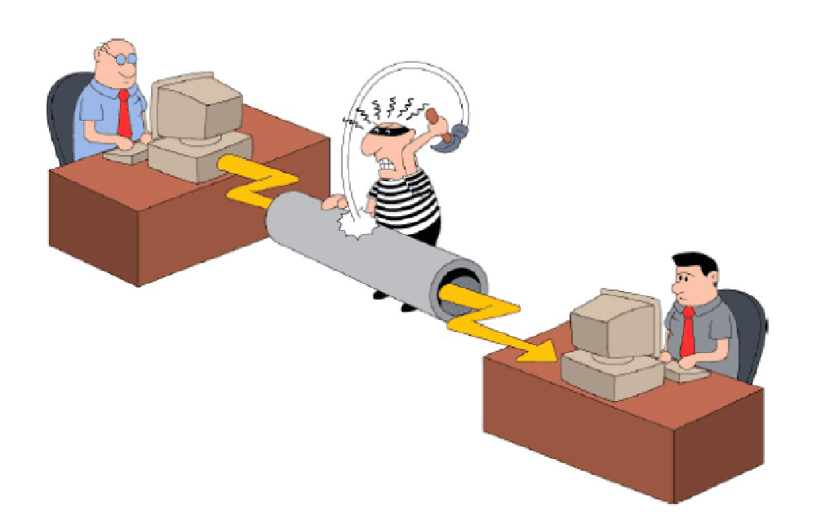
Introduction to Information & N/W Security

Slide 6
Why Security

Slide 7
Cryptography and Cryptanalysis
Cryptography and Cryptanalysis
Cryptography is the study of the design of techniques for ensuring the secrecy and/or authenticity of information
Cryptanalysis deals with the defeating such techniques to recover information, or forging information that will be accepted as authentic
Notes:
either "writing" or a "field of study"
Calligraphy
Geography
cinematography
autobiography

Slide 8
Cryptographic Algorithms
Cryptographic algorithms and protocols can be grouped into four main areas
Cryptographic algorithms and protocols
Symmetric encryption
Asymmetric encryption
Data integrity algorithms
Authentication protocols
Data integrity algorithms used to protect blocks of data, such as messages, from alteration.
Authentication Protocols are schemes based on the use of cryptographic algorithms designed to authenticate the identity of entities.
Symmetric encryption used to secure the contents of blocks or streams of data of any size, including messages, files, encryption keys, and passwords
Asymmetric encryption used to conceal small blocks of data, such as encryption keys and hash function values, which are used in digital signatures.

Slide 9
Security Objectives
Security objectives for information and computing services are Confidentiality, Integrity, Availability, Authenticity, Accountability.
Confidentiality:
Data confidentiality: Assures that private or confidential information is not made available or disclosed to unauthorized individuals.
Privacy: Assures that individuals control what information related to them may be collected and stored and by whom and to whom that information may be disclosed.

Slide 10
Security Objectives (Cont…)
Integrity:
Data integrity: Assures that information and programs are changed only in a specified and authorized manner.
System integrity: Assures that a system performs its intended function in an unimpaired manner, free from deliberate or inadvertent unauthorized manipulation of the system.
Availability: Assures that systems work promptly and service is not denied to authorized users.

Slide 11
Security Objectives (Cont…)
Authenticity:
The property of being genuine and being able to be verified and trusted; confidence in the validity of a transmission, a message, or message originator.
This means verifying that each input arriving at the system came from a trusted source.
Accountability:
The security goal that generates the requirement for actions of an entity to be traced uniquely to that entity.
This supports nonrepudiation, deterrence, fault isolation, intrusion detection and prevention, and after-action recovery and legal action.

Slide 12
Threat and Attack
Threat: A potential for violation of security, which exists when there is a circumstance, capability, action, or event that could crack security and cause harm. That is, a threat is a possible danger that might exploit a vulnerability.
Attack: An violation on system security that derives from an intelligent threat; that is, an intelligent act that is a calculated attempt to avoid security services and violate the security policy of a system.

Slide 13
Computer Security
the protection afforded to an automated information system
in order to attain the applicable objectives of preserving the
confidentiality – student grades
integrity – patient information
availability – authentication service
information system resources
(includes hardware, software, firmware, information/data, and telecommunications)
Notes:
The NIST Computer Security Handbook [NIST95] defines the term computer security as shown on this slide. This definition introduces three key objectives that are at the heart of computer security as we see on the next slide.

Slide 14
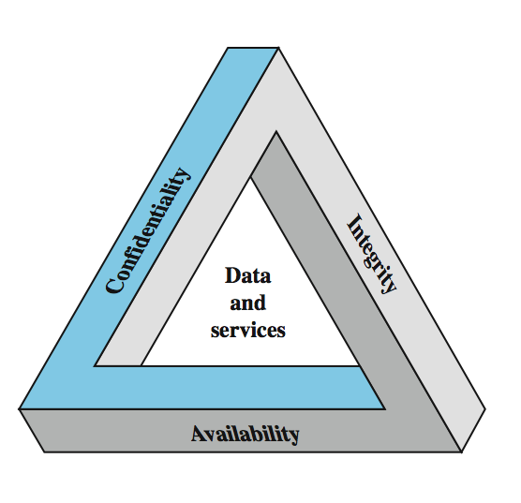
Key Security Concepts
Notes:
These three concepts form what is often referred to as the CIA triad (Figure 1.1). The three concepts embody the fundamental security objectives for both data and for information and computing services. FIPS PUB 199 provides a useful characterization of these three objectives in terms of requirements and the definition of a loss of security in each category:
• Confidentiality (covers both data confidentiality and privacy): preserving authorized restrictions on information access and disclosure, including means for protecting personal privacy and proprietary information. A loss of confidentiality is the unauthorized disclosure of information.
• Integrity (covers both data and system integrity): Guarding against improper information modification or destruction, and includes ensuring information non-repudiation and authenticity. A loss of integrity is the unauthorized modification or destruction of information.
• Availability: Ensuring timely and reliable access to and use of information. A loss of availability is the disruption of access to or use of information or an information system.
Although the use of the CIA triad to define security objectives is well established, some in the security field feel that additional concepts are needed to present a complete picture. Two of the most commonly mentioned are:
• Authenticity: The property of being genuine and being able to be verified and trusted; confidence in the validity of a transmission, a message, or message originator.
• Accountability: The security goal that generates the requirement for actions of an entity to be traced uniquely to that entity.

Slide 15
Levels of Impact
can define 3 levels of impact from a security breach
Low
minor damage to organizational assets
minor financial loss
minor harm to individuals
Moderate
High
Notes:
We can define three levels of impact on organizations or individuals should there be a breach of security (i.e., a loss of confidentiality, integrity, or availability). These levels are defined in FIPS PUB 199:
• Low: The loss could be expected to have a limited adverse effect on organizational operations, organizational assets, or individuals. A limited adverse effect means that, for example, the loss of confidentiality, integrity, or availability might (i) cause a degradation in mission capability to an extent and duration that the organization is able to perform its primary functions, but the effectiveness of the functions is noticeably reduced; (ii) result in minor damage to organizational assets; (iii) result in minor financial loss; or (iv) result in minor harm to individuals.
• Moderate: The loss could be expected to have a serious adverse effect on organizational operations, organizational assets, or individuals. A serious adverse effect means that, for example, the loss might (i) cause a significant degradation in mission capability to an extent and duration that the organization is able to perform its primary functions, but the effectiveness of the functions is significantly reduced; (ii) result in significant damage to organizational assets; (iii) result in significant financial loss; or (iv) result in significant harm to individuals that does not involve loss of life or serious, life-threatening injuries.
• High: The loss could be expected to have a severe or catastrophic adverse effect on organizational operations, organizational assets, or individuals. A severe or catastrophic adverse effect means that, for example, the loss might (i) cause a severe degradation in or loss of mission capability to an extent and duration that the organization is not able to perform one or more of its primary functions; (ii) result in major damage to organizational assets; (iii) result in major financial loss; or (iv) result in severe or catastrophic harm to individuals involving loss of life or serious life threatening injuries.

Slide 16
Levels of Impact
can define 3 levels of impact from a security breach
Low
Moderate
significant damage to organizational assets
significant financial loss
does not involve loss of life or serious, life-threatening injuries
High
Notes:
We can define three levels of impact on organizations or individuals should there be a breach of security (i.e., a loss of confidentiality, integrity, or availability). These levels are defined in FIPS PUB 199:
• Low: The loss could be expected to have a limited adverse effect on organizational operations, organizational assets, or individuals. A limited adverse effect means that, for example, the loss of confidentiality, integrity, or availability might (i) cause a degradation in mission capability to an extent and duration that the organization is able to perform its primary functions, but the effectiveness of the functions is noticeably reduced; (ii) result in minor damage to organizational assets; (iii) result in minor financial loss; or (iv) result in minor harm to individuals.
• Moderate: The loss could be expected to have a serious adverse effect on organizational operations, organizational assets, or individuals. A serious adverse effect means that, for example, the loss might (i) cause a significant degradation in mission capability to an extent and duration that the organization is able to perform its primary functions, but the effectiveness of the functions is significantly reduced; (ii) result in significant damage to organizational assets; (iii) result in significant financial loss; or (iv) result in significant harm to individuals that does not involve loss of life or serious, life-threatening injuries.
• High: The loss could be expected to have a severe or catastrophic adverse effect on organizational operations, organizational assets, or individuals. A severe or catastrophic adverse effect means that, for example, the loss might (i) cause a severe degradation in or loss of mission capability to an extent and duration that the organization is not able to perform one or more of its primary functions; (ii) result in major damage to organizational assets; (iii) result in major financial loss; or (iv) result in severe or catastrophic harm to individuals involving loss of life or serious life threatening injuries.

Slide 17
Levels of Impact
can define 3 levels of impact from a security breach
Low
Moderate
High
major damage to organizational assets
major financial loss
harm to individuals involving loss of life or serious life threatening injuries
Notes:
We can define three levels of impact on organizations or individuals should there be a breach of security (i.e., a loss of confidentiality, integrity, or availability). These levels are defined in FIPS PUB 199:
• Low: The loss could be expected to have a limited adverse effect on organizational operations, organizational assets, or individuals. A limited adverse effect means that, for example, the loss of confidentiality, integrity, or availability might (i) cause a degradation in mission capability to an extent and duration that the organization is able to perform its primary functions, but the effectiveness of the functions is noticeably reduced; (ii) result in minor damage to organizational assets; (iii) result in minor financial loss; or (iv) result in minor harm to individuals.
• Moderate: The loss could be expected to have a serious adverse effect on organizational operations, organizational assets, or individuals. A serious adverse effect means that, for example, the loss might (i) cause a significant degradation in mission capability to an extent and duration that the organization is able to perform its primary functions, but the effectiveness of the functions is significantly reduced; (ii) result in significant damage to organizational assets; (iii) result in significant financial loss; or (iv) result in significant harm to individuals that does not involve loss of life or serious, life-threatening injuries.
• High: The loss could be expected to have a severe or catastrophic adverse effect on organizational operations, organizational assets, or individuals. A severe or catastrophic adverse effect means that, for example, the loss might (i) cause a severe degradation in or loss of mission capability to an extent and duration that the organization is not able to perform one or more of its primary functions; (ii) result in major damage to organizational assets; (iii) result in major financial loss; or (iv) result in severe or catastrophic harm to individuals involving loss of life or serious life threatening injuries.

Slide 18
Computer Security Challenges
not simple
must consider potential attacks
procedures used counter-intuitive
involve algorithms and secret info
must decide where to deploy mechanisms
battle of wits between attacker / admin
not perceived on benefit until fails
requires regular monitoring
too often an after-thought
regarded as impediment to using system
Notes:
Computer security is both fascinating and complex. Some of the reasons follow:
1. Computer security is not as simple as it might first appear to the novice. The requirements seem to be straightforward, but the mechanisms used to meet those requirements can be quite complex and subtle.
2. In developing a particular security mechanism or algorithm, one must always consider potential attacks (often unexpected) on those security features.
3. Hence procedures used to provide particular services are often counterintuitive.
4. Having designed various security mechanisms, it is necessary to decide where to use them.
5. Security mechanisms typically involve more than a particular algorithm or protocol, but also require participants to have secret information, leading to issues of creation, distribution, and protection of that secret information.
6. Computer security is essentially a battle of wits between a perpetrator who tries to find holes and the designer or administrator who tries to close them.
7. There is a natural tendency on the part of users and system managers to perceive little benefit from security investment until a security failure occurs.
8. Security requires regular monitoring, difficult in today's short-term environment.
9. Security is still too often an afterthought - incorporated after the design is complete.
10. Many users / security administrators view strong security as an impediment to efficient and user-friendly operation of an information system or use of information.

Slide 19
Aspects of Security
consider 3 aspects of information security:
Security Attack: Any action that compromises the security of information owned by an organization.
Security Mechanism: A process that is designed to detect, prevent, or recover from a security attack.
Security Service: A communication service that enhances the security of the data processing systems and the information transfers of an organization.
Notes:
The OSI security architecture focuses on security attacks, mechanisms, and services. These can be defined briefly as follows:
• Security attack: Any action that compromises the security of information owned by an organization.
• Security mechanism: A process (or a device incorporating such a process) that is designed to detect, prevent, or recover from a security attack.
• Security service: A processing or communication service that enhances the security of the data processing systems and the information transfers of an organization. The services are intended to counter security attacks, and they make use of one or more security mechanisms to provide the service.
In the literature, the terms threat and attack are commonly used to mean more or less the same thing. Table 1.1 provides definitions taken from RFC 2828, Internet Security Glossary.
Threat - A potential for violation of security, which exists when there is a circumstance, capability, action, or event that could breach security and cause harm. That is, a threat is a possible danger that might exploit a vulnerability.
Attack - An assault on system security that derives from an intelligent threat; that is, an intelligent act that is a deliberate attempt (especially in the sense of a method or technique) to evade security services and violate the security policy of a system.

Slide 20
Security Attacks
A passive attack attempts to learn or make use of information from the system but does not affect system resources.
Release of message contents
Traffic analysis
An active attack attempts to alter system resources or affect their operation.
Masquerade
Replay
Modification of messages
Denial of service.

Slide 21
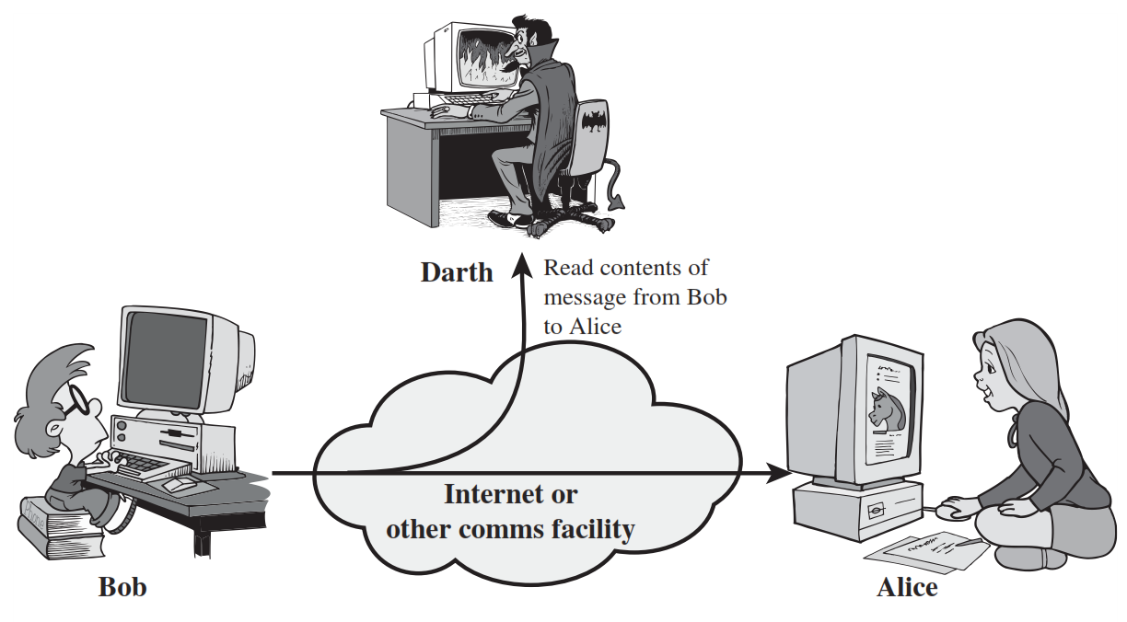
1) Release of message contents (Passive Attack)
A telephone conversation, an electronic mail message, and a transferred file may contain sensitive or confidential information.
We would like to prevent an opponent from learning the contents of these transmissions.

Slide 22
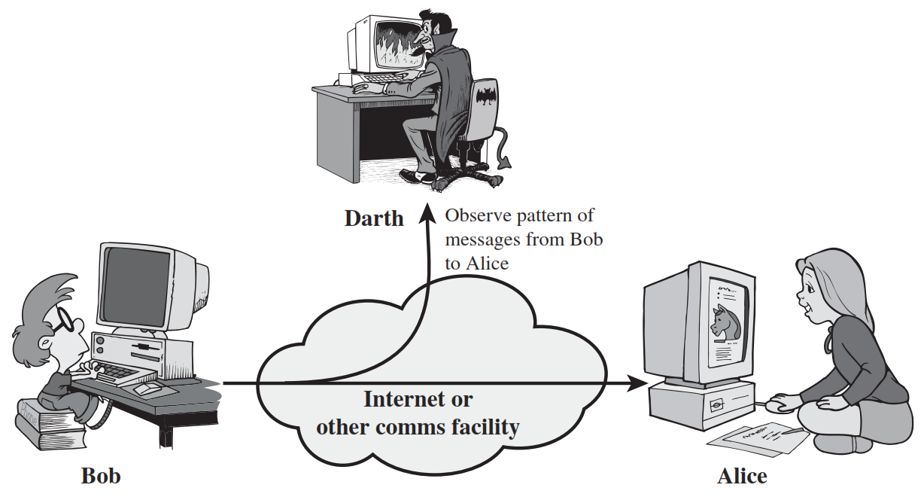
2) Traffic Analysis (Passive Attack)
In such attacks, an adversary, capable of observing network traffic statistics in several different networks, correlates the traffic patterns in these networks.

Slide 23
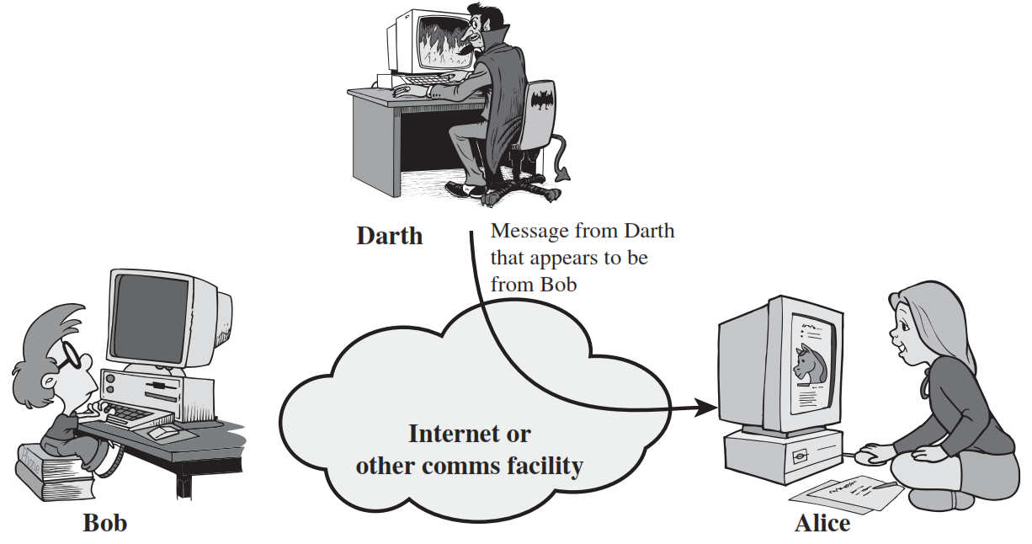
1) Masquerade Attack (Active Attack)
A masquerade takes place when one entity pretends to be a different entity.

Slide 24

2) Replay Attack (Active Attack)
Replay attack involves the passive capture of a data unit and its subsequent retransmission to produce an unauthorized effect.

Slide 25
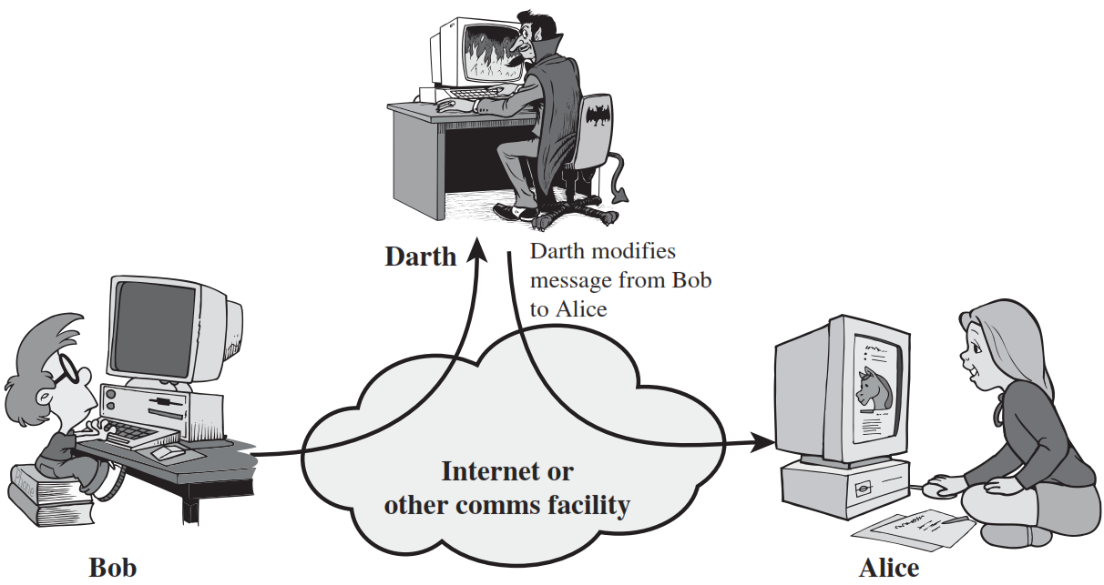
3) Modification of messages Attack (Active Attack)
Modification of messages simply means that some portion of a legitimate message is altered, or that messages are delayed or reordered, to produce an unauthorized effect.

Slide 26
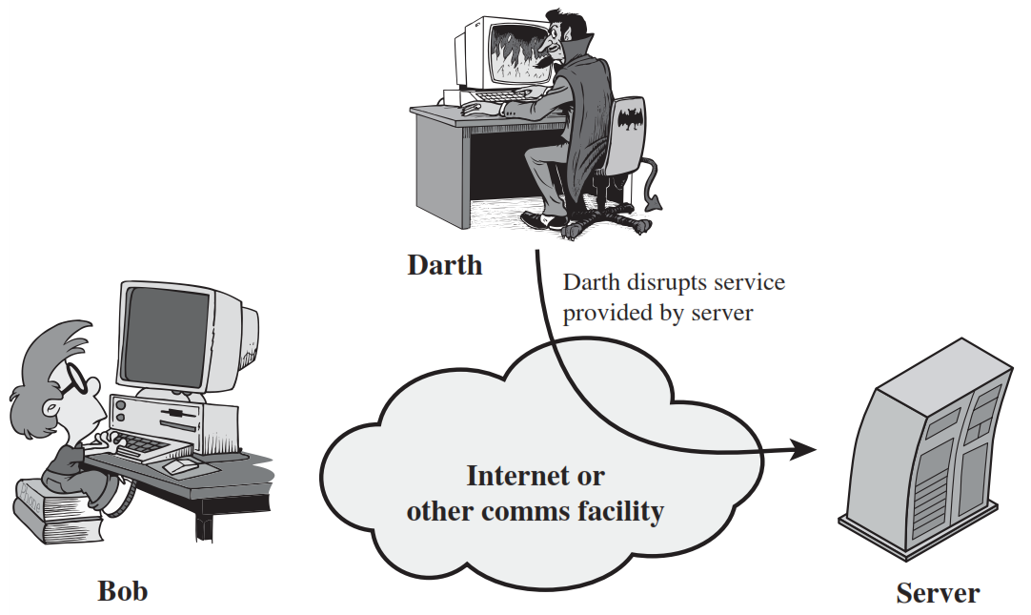
4) Denial of Service Attack (Active Attack)
The denial of service attack prevents the normal use or management of communications facilities.

Slide 27
Aspects of Security
consider 3 aspects of information security:
Security Attack: Any action that compromises the security of information owned by an organization.
Security Service: A communication service that enhances the security of the data processing systems and the information transfers of an organization.
Security Mechanism: A process that is designed to detect, prevent, or recover from a security attack.
Notes:
The OSI security architecture focuses on security attacks, mechanisms, and services. These can be defined briefly as follows:
• Security attack: Any action that compromises the security of information owned by an organization.
• Security mechanism: A process (or a device incorporating such a process) that is designed to detect, prevent, or recover from a security attack.
• Security service: A processing or communication service that enhances the security of the data processing systems and the information transfers of an organization. The services are intended to counter security attacks, and they make use of one or more security mechanisms to provide the service.
In the literature, the terms threat and attack are commonly used to mean more or less the same thing. Table 1.1 provides definitions taken from RFC 2828, Internet Security Glossary.
Threat - A potential for violation of security, which exists when there is a circumstance, capability, action, or event that could breach security and cause harm. That is, a threat is a possible danger that might exploit a vulnerability.
Attack - An assault on system security that derives from an intelligent threat; that is, an intelligent act that is a deliberate attempt (especially in the sense of a method or technique) to evade security services and violate the security policy of a system.

Slide 28
Security Mechanism
feature designed to detect, prevent, or recover from a security attack
no single mechanism that will support all services required
however one particular element underlies many of the security mechanisms in use:
cryptographic techniques
hence our focus on this topic
Notes:
Now introduce “Security Mechanism” which are the specific means of implementing one or more security services. Note these mechanisms span a wide range of technical components, but one aspect seen in many is the use of cryptographic techniques.

Slide 29
Security Mechanisms (X.800)
specific security mechanisms:
encipherment, digital signatures, access controls, data integrity, authentication exchange, traffic padding, routing control, notarization
pervasive security mechanisms:
trusted functionality, security labels, event detection, security audit trails, security recovery
Notes:
Some examples of mechanisms from X.800. Note that the “specific security mechanisms” are protocol layer specific, whilst the “pervasive security mechanisms” are not. We will meet some of these mechanisms in much greater detail later.
See Stallings Table 1.3 for details of these mechanisms in X.800, and Table 1.4 for the relationship between services and mechanisms.

Slide 30
Security Mechanism (Specific Security)
Encipherment: Hiding or covering data using mathematical algorithms.
Digital Signature: The sender can electronically sign the data and the receiver can electronically verify the signature.
Access Control: A variety of mechanisms that enforce access rights to resources.
Data Integrity: A variety of mechanisms used to assure the integrity of a data unit or stream of data units.
Authentication Exchange: Two entities exchange some messages to prove their identity to each other.

Slide 31
Security Mechanism (Specific security)
Traffic Padding: The insertion of bits into gaps in a data stream to frustrate traffic analysis attempts.
Routing Control: Selecting and continuously changing routes between sender and receiver to prevent opponent from eavesdropping.
Notarization: The use of a trusted third party to assure and control the communication.

Slide 32
Aspects of Security
consider 3 aspects of information security:
Security Attack: Any action that compromises the security of information owned by an organization.
Security Service: A communication service that enhances the security of the data processing systems and the information transfers of an organization.
Security Mechanism: A process that is designed to detect, prevent, or recover from a security attack.
Notes:
The OSI security architecture focuses on security attacks, mechanisms, and services. These can be defined briefly as follows:
• Security attack: Any action that compromises the security of information owned by an organization.
• Security mechanism: A process (or a device incorporating such a process) that is designed to detect, prevent, or recover from a security attack.
• Security service: A processing or communication service that enhances the security of the data processing systems and the information transfers of an organization. The services are intended to counter security attacks, and they make use of one or more security mechanisms to provide the service.
In the literature, the terms threat and attack are commonly used to mean more or less the same thing. Table 1.1 provides definitions taken from RFC 2828, Internet Security Glossary.
Threat - A potential for violation of security, which exists when there is a circumstance, capability, action, or event that could breach security and cause harm. That is, a threat is a possible danger that might exploit a vulnerability.
Attack - An assault on system security that derives from an intelligent threat; that is, an intelligent act that is a deliberate attempt (especially in the sense of a method or technique) to evade security services and violate the security policy of a system.

Slide 33
Security Service
enhance security of data processing systems and information transfers of an organization
intended to counter security attacks
using one or more security mechanisms
often replicates functions normally associated with physical documents
which, for example, have signatures, dates; need protection from disclosure, tampering, or destruction; be notarized or witnessed; be recorded or licensed
Notes:
Consider the role of a security service, and what may be required.
Note both similarities and differences with traditional paper documents, which for example:
have signatures & dates;
need protection from disclosure, tampering, or destruction;
may be notarized or witnessed;
may be recorded or licensed

Slide 34
Security Services
X.800:
“a service provided by a protocol layer of communicating open systems, which ensures adequate security of the systems or of data transfers”
RFC 2828:
“a processing or communication service provided by a system to give a specific kind of protection to system resources”
Notes:
State here a couple of definitions of “security services” from relevant standards. X.800 defines a security service as a service provided by a protocol layer of communicating open systems, which ensures adequate security of the systems or of data transfers. Perhaps a clearer definition is found in RFC 2828, which provides the following definition: a processing or communication service that is provided by a system to give a specific kind of protection to system resources; security services implement security policies and are implemented by security mechanisms.

Slide 35
Security Services (X.800)
Authentication - assurance that communicating entity is the one claimed
have both peer-entity & data origin authentication
Access Control - prevention of the unauthorized use of a resource
Data Confidentiality –protection of data from unauthorized disclosure
Data Integrity - assurance that data received is as sent by an authorized entity
Non-Repudiation - protection against denial by one of the parties in a communication
Availability – resource accessible/usable
Notes:
This list is taken from Stallings Table 1.2 which provides details of the 5 Security Service categories and the 14 specific services given in X.800.
This list includes the various "classic" security services which are traditionally discussed. Note there is a degree of ambiguity as to the meaning of these terms, and overlap in their use. The broad service categories are:
authentication is concerned with assuring that a communication is authentic. Two specific authentication services are defined in X.800: Peer entity authentication: provides corroboration of the identity of a peer entity in an association; and Data origin authentication: provides corroboration of the source of a data unit.
access control is the ability to limit and control the access to host systems and applications via communications links.
confidentiality is the protection of transmitted data from passive attacks, and the protection of traffic flow from analysis.
integrity assures that messages are received as sent, with no duplication, insertion, modification, reordering, replay, or loss.
availability is the property of a system / resource being accessible and usable upon demand by an authorized system entity, according to performance specifications for the system.

Slide 36
Security Services
Authentication
Access Control
Data Confidentiality
Data Integrity
Non Repudiation
Peer Entity Authentication
Connection Confidentiality
Connection Integrity with recovery
Non Repudiation Origin
Data Origin Authentication
Connection less Confidentiality
Connection Integrity with out recovery
Non Repudiation Destination
Selective Repeat Confidentiality
Selective Field Connection Integrity
Traffic Flow Confidentiality
Connection less Integrity
Selective Field Connection less Integrity

Slide 37
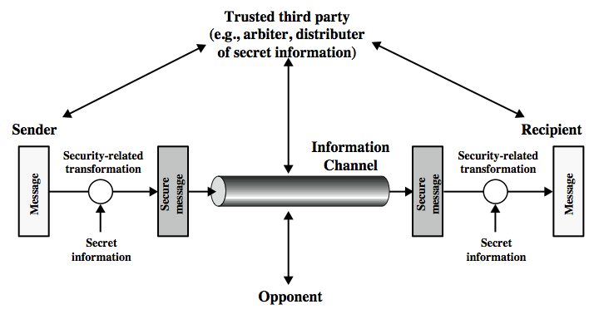
Model for Network Security
Notes:
In considering the place of encryption, its useful to use the following two models from Stallings section 1.6.
The first, illustrated in Figure 1.4, models information being transferred from one party to another over an insecure communications channel, in the presence of possible opponents. The two parties, who are the principals in this transaction, must cooperate for the exchange to take place. They can use an appropriate security transform (encryption algorithm), with suitable keys, possibly negotiated using the presence of a trusted third party. Parts One through Four of this book concentrates on the types of security mechanisms and services that fit into the model shown here.

Slide 38
Model for Network Security
using this model requires us to:
design a suitable algorithm for the security transformation
generate the secret information (keys) used by the algorithm
develop methods to distribute and share the secret information
specify a protocol enabling the principals to use the transformation and secret information for a security service
Notes:
This general model shows that there are four basic tasks in designing a particular security service, as listed.

Slide 39
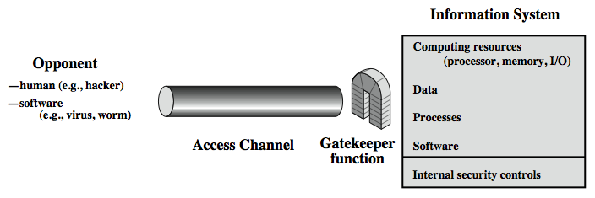
Model for Network Access Security
Notes:
The second, illustrated in Figure 1.5, model is concerned with controlled access to information or resources on a computer system, in the presence of possible opponents. Here appropriate controls are needed on the access to and within the system, to provide suitable security.
The security mechanisms needed to cope with unwanted access fall into two broad categories (as shown in this figure). The first category might be termed a gatekeeper function. It includes password-based login procedures that are designed to deny access to all but authorized users and screening logic that is designed to detect and reject worms, viruses, and other similar attacks. Once either an unwanted user or unwanted software gains access, the second line of defense consists of a variety of internal controls that monitor activity and analyze stored information in an attempt to detect the presence of unwanted intruders. These issues are explored in Part Four.

Slide 40
Model for Network Access Security
using this model requires us to:
select appropriate gatekeeper functions to identify users
implement security controls to ensure only authorised users access designated information or resources
Notes:
Detail here the tasks needed to use this model.

Slide 41
Some Basic Terminology
plaintext - original message
ciphertext - coded message
cipher - algorithm for transforming plaintext to ciphertext
key - info used in cipher known only to sender/receiver
encipher (encrypt) - converting plaintext to ciphertext
decipher (decrypt) - recovering ciphertext from plaintext
cryptography - study of encryption principles/methods
cryptanalysis (codebreaking) - study of principles/ methods of deciphering ciphertext without knowing key
cryptology - field of both cryptography and cryptanalysis
Notes:
Briefly review some terminology used throughout the course.

Slide 42
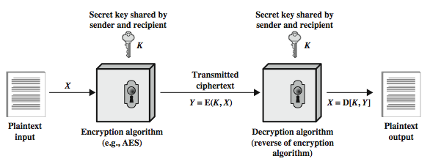
Symmetric Cipher Model
Notes:
Detail the five ingredients of the symmetric cipher model, shown in Stallings Figure 2.1:
plaintext - original message
encryption algorithm – performs substitutions/transformations on plaintext
secret key – control exact substitutions/transformations used in encryption algorithm
ciphertext - scrambled message
decryption algorithm – inverse of encryption algorithm

Slide 43
Requirements
two requirements for secure use of symmetric encryption:
a strong encryption algorithm
a secret key known only to sender / receiver
mathematically have:
Y = E(K, X)
X = D(K, Y)
assume encryption algorithm is known
implies a secure channel to distribute key
Notes:
There are two requirements for secure use of conventional encryption that mean we assume that it is impractical to decrypt a message on the basis of the cipher- text plus knowledge of the encryption/decryption algorithm, and hence do not need to keep the algorithm secret; rather we only need to keep the key secret. This feature of symmetric encryption is what makes it feasible for widespread use. It allows easy distribution of s/w and h/w implementations.
Can take a closer look at the essential elements of a symmetric encryption scheme: mathematically it can be considered a pair of functions with: plaintext X, ciphertext Y, key K, encryption algorithm E, decryption algorithm D. The intended receiver, in possession of the key, is able to invert the transformation. An opponent, observing Y but not having access to K or X, may attempt to recover X or K.

Slide 44
Cryptography
can characterize cryptographic system by:
type of encryption operations used
substitution
transposition
product
number of keys used
single-key or private
two-key or public
way in which plaintext is processed
block
stream
Notes:
Cryptographic systems can be characterized along these three independent dimensions.
The type of operations used for transforming plaintext to ciphertext. All encryption algorithms are based on two general principles: substitution, in which each element in the plaintext (bit, letter, group of bits or letters) is mapped into another element, and transposition, in which elements in the plaintext are rearranged. The fundamental requirement is that no information be lost (that is, that all operations are reversible). Most systems, referred to as product systems, involve multiple stages of substitutions and transpositions.
The number of keys used. If both sender and receiver use the same key, the system is referred to as symmetric, single-key, secret-key, or conventional encryption. If the sender and receiver use different keys, the system is referred to as asymmetric, two-key, or public-key encryption.
The way in which the plaintext is processed. A block cipher processes the input one block of elements at a time, producing an output block for each input block. A stream cipher processes the input elements continuously, producing output one element at a time, as it goes along.

Slide 45
Cryptanalysis and Brute-Force Attack
Cryptanalysis: Cryptanalytic attacks rely on the nature of the algorithm and some knowledge of the general characteristics of the plaintext or even some sample plaintext–ciphertext pairs.
This type of attack exploits the characteristics of the algorithm to attempt to derive a specific plaintext or to derive the key being used.
Brute-force attack: The attacker tries every possible key on a piece of ciphertext until an intelligible translation into plaintext is obtained.
On average, half of all possible keys must be tried to achieve success.

Slide 46
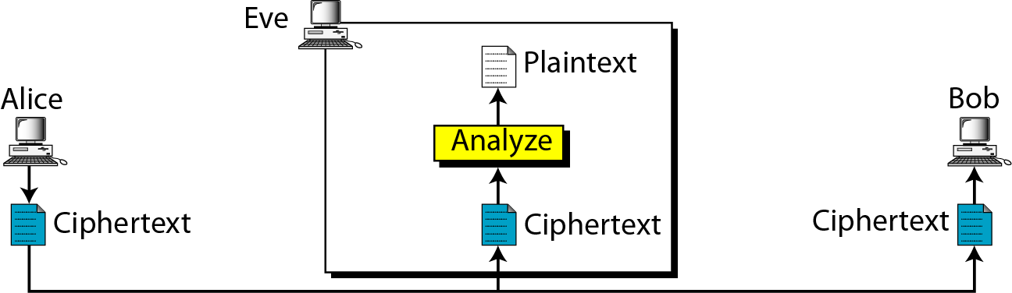
Attacks on Encrypted Messages
Type of Attack | Known to cryptanalyst
Ciphertext Only | Encryption algorithm, Ciphertext

Slide 47
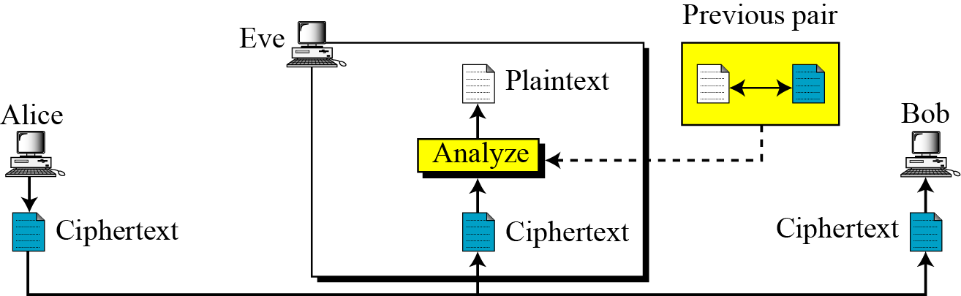
Attacks on Encrypted Messages
Type of Attack | Known to cryptanalyst
Known Plaintext | Encryption algorithm, Ciphertext, One or more plaintext-cipher text pairs formed with the secret key

Slide 48
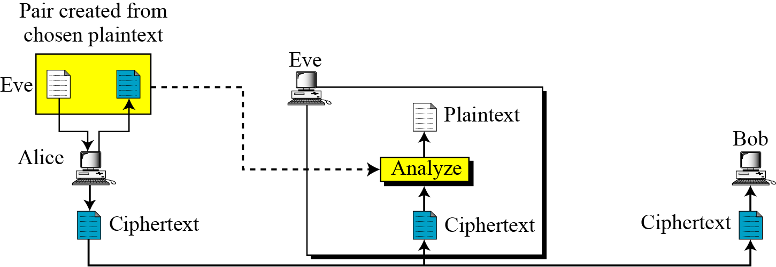
Attacks on Encrypted Messages
Type of Attack | Known to cryptanalyst
Chosen Plaintext | Encryption algorithm, Ciphertext, Plaintext message chosen by cryptanalyst

Slide 49
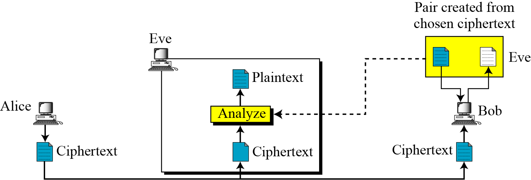
Attacks on Encrypted Messages
Type of Attack | Known to cryptanalyst
Chosen Ciphertext | Encryption algorithm, Ciphertext, Ciphertext chosen by cryptanalyst, with its corresponding decrypted plaintext generated with the secret key

Slide 50
Attacks on Encrypted Messages
Type of Attack | Known to cryptanalyst
Chosen text | Encryption algorithm, Ciphertext, Plaintext chosen by cryptanalyst, with its corresponding ciphertext generated with the secret key , Ciphertext chosen by cryptanalyst, with its corresponding decrypted plaintext generated with the secret key

Slide 51
More Definitions
unconditional security
no matter how much computer power or time is available, the cipher cannot be broken since the ciphertext provides insufficient information to uniquely determine the corresponding plaintext
computational security
given limited computing resources (eg time needed for calculations is greater than age of universe), the cipher cannot be broken
Notes:
Two more definitions are worthy of note. An encryption scheme is unconditionally secure if the ciphertext generated by the scheme does not contain enough information to determine uniquely the corresponding plaintext, no matter how much ciphertext is available. An encryption scheme is said to be computationally secure if either the cost of breaking the cipher exceeds the value of the encrypted information, or the time required to break the cipher exceeds the useful lifetime of the information. Unconditional security would be nice, but the only known such cipher is the one-time pad (later).
For all reasonable encryption algorithms, we have to assume computational security where it either takes too long, or is too expensive, to bother breaking the cipher.

Slide 52
Brute Force Search
always possible to simply try every key
most basic attack, proportional to key size
assume either know / recognise plaintext
Key Size (bits) | Number of Alternative Keys | Time required at 1 decryption/µs | Time required at 10⁶ decryptions/µs
32 | 2³² = 4.3 × 10⁹ | 2³¹ µs = 35.8 minutes | 2.15 milliseconds
56 | 2⁵⁶ = 7.2 × 10¹⁶ | 2⁵⁵ µs = 1142 years | 10.01 hours
128 | 2¹²⁸ = 3.4 × 10³⁸ | 2¹²⁷ µs = 5.4 × 10²⁴ years | 5.4 × 10¹⁸ years
168 | 2¹⁶⁸ = 3.7 × 10⁵⁰ | 2¹⁶⁷ µs = 5.9 × 10³⁶ years | 5.9 × 10³⁰ years
26 characters (permutation) | 26! = 4 × 10²⁶ | 2 × 10²⁶ µs = 6.4 × 10¹² years | 6.4 × 10⁶ years
Notes:
A brute-force attack involves trying every possible key until an intelligible translation of the ciphertext into plaintext is obtained. On average, half of all possible keys must be tried to achieve success. Stallings Table 2.2 shows how much time is required to conduct a brute-force attack, for various common key sizes (DES is 56, AES is 128, Triple-DES is 168, plus general mono-alphabetic cipher), where either a single system or a million parallel systems, are used.

Slide 53
Classical Substitution Ciphers
where letters of plaintext are replaced by other letters or by numbers or symbols
or if plaintext is viewed as a sequence of bits, then substitution involves replacing plaintext bit patterns with ciphertext bit patterns
Notes:
In this section and the next, we examine a sampling of what might be called classical encryption techniques. A study of these techniques enables us to illustrate the basic approaches to symmetric encryption used today and the types of cryptanalytic attacks that must be anticipated. The two basic building blocks of all encryption technique are substitution and transposition. We examine these in the next two sections. Finally, we discuss a system that combine both substitution and transposition.
A substitution technique is one in which the letters of plaintext are replaced by other letters or by numbers or symbols. If the plaintext is viewed as a sequence of bits, then substitution involves replacing plaintext bit patterns with ciphertext bit patterns.

Slide 54
Caesar Cipher
earliest known substitution cipher
by Julius Caesar
first attested use in military affairs
replaces each letter by 2rd letter on
example:
meet me after the toga party
PHHW PH DIWHU WKH WRJD SDUWB
Notes:
Substitution ciphers form the first of the fundamental building blocks. The core idea is to replace one basic unit (letter/byte) with another. Whilst the early Greeks described several substitution ciphers, the first attested use in military affairs of one was by Julius Caesar, described by him in Gallic Wars (cf. Kahn pp83-84). Still call any cipher using a simple letter shift a caesar cipher, not just those with shift 3.

Slide 55
Caesar Cipher
can define transformation as:
a b c d e f g h i j k l m n o p q r s t u v w x y z
D E F G H I J K L M N O P Q R S T U V W X Y Z A B C
mathematically give each letter a number
a b c d e f g h i j k l m n o p q r s t u v w x y z
0 1 2 3 4 5 6 7 8 9 10 11 12 13 14 15 16 17 18 19 20 21 22 23 24 25
then have Caesar cipher as:
c = E(k, p) = (p + k) mod (26)
p = D(k, c) = (c – k) mod (26)
Notes:
This mathematical description uses modulo (clock) arithmetic. Here, when you reach Z you go back to A and start again. Mod 26 implies that when you reach 26, you use 0 instead (ie the letter after Z, or 25 + 1 goes to A or 0).
Example: howdy (7,14,22,3,24) encrypted using key f (ie a shift of 5) is MTBID

Slide 56
Cryptanalysis of Caesar Cipher
only have 26 possible ciphers
A maps to A,B,..Z
could simply try each in turn
a brute force search
given ciphertext, just try all shifts of letters
do need to recognize when have plaintext
eg. break ciphertext "GCUA VQ DTGCM“
easy to break Shift = 2
Notes:
With a caesar cipher, there are only 26 possible keys, of which only 25 are of any use, since mapping A to A etc doesn't really obscure the message! Note this basic rule of cryptanalysis "check to ensure the cipher operator hasn't goofed and sent a plaintext message by mistake"!
Can try each of the keys (shifts) in turn, until can recognise the original message. See Stallings Fig 2.3 for example of search.
Note: as mentioned before, do need to be able to recognise when have an original message (ie is it English or whatever). Usually easy for humans, hard for computers. Though if using say compressed data could be much harder.
Example "GCUA VQ DTGCM" when broken gives "easy to break", with a shift of 2 (key C).

Slide 57
Test
Ciphertext: ZNK WAOIQ HXUCT LUD
THE QUICK BROWN FOX (6)

Slide 58
Monoalphabetic Cipher
rather than just shifting the alphabet
could shuffle (jumble) the letters arbitrarily
each plaintext letter maps to a different random ciphertext letter
hence key is 26 letters long
Plain: abcdefghijklmnopqrstuvwxyz
Cipher: DKVQFIBJWPESCXHTMYAUOLRGZN
Plaintext: ifwewishtoreplaceletters
Ciphertext: WIRFRWAJUHYFTSDVFSFUUFYA
Notes:
With only 25 possible keys, the Caesar cipher is far from secure. A dramatic increase in the key space can be achieved by allowing an arbitrary substitution, where the translation alphabet can be any permutation of the 26 alphabetic characters. A permutation of a finite set of elements S is an ordered sequence of all the elements of S, with each element appearing exactly once. In general, there are n! permutations of a set of n elements.
See text example of a translation alphabet, and an encrypted message using it.

Slide 59
Monoalphabetic Cipher Security
now have a total of 26! = 4 x 10²⁶ keys
with so many keys, might think is secure
but would be !!!WRONG!!!
problem is language characteristics
Notes:
Note that even given the very large number of keys, being 10 orders of magnitude greater than the key space for DES, the monoalphabetic substitution cipher is not secure, because it does not sufficiently obscure the underlying language characteristics.

Slide 60
Language Redundancy and Cryptanalysis
human languages are redundant
letters are not equally commonly used
in English E is by far the most common letter
followed by T,R,N,I,O,A,S
other letters like Z,J,K,Q,X are fairly rare
have tables of single, double & triple letter frequencies for various languages
Notes:
As the example shows, we don't actually need all the letters in order to understand written English text. Here vowels were removed, but they're not the only redundancy. cf written Hebrew has no vowels for same reason. Are usually familiar with "party conversations", can hear one person speaking out of hubbub of many, again because of redundancy in aural language also. This redundancy is also the reason we can compress text files, the computer can derive a more compact encoding without losing any information. Basic idea is to count the relative frequencies of letters, and note the resulting pattern.

Slide 61
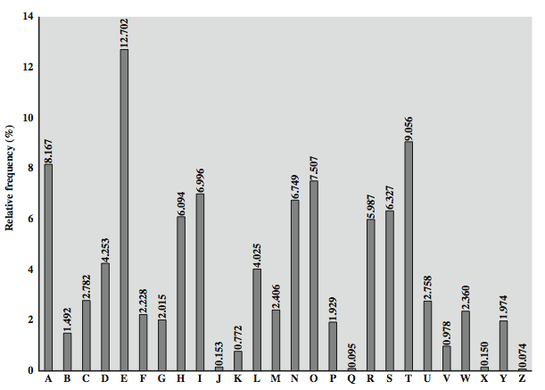
English Letter Frequencies
Notes:
Note that all human languages have varying letter frequencies, though the number of letters and their frequencies varies. Stallings Figure 2.5 shows English letter frequencies. Seberry & Pieprzyk, "Cryptography - An Introduction to Computer Security", Prentice-Hall 1989, Appendix A has letter frequency graphs for 20 languages (most European & Japanese & Malay). Also useful are tables of common two-letter combinations, known as digrams, and three-letter combinations, known as trigrams.

Slide 62
Use in Cryptanalysis
key concept - monoalphabetic substitution ciphers do not change relative letter frequencies
discovered by Arabian scientists in 9th century
calculate letter frequencies for ciphertext
compare counts/plots against known values
if caesar cipher look for common peaks/troughs
peaks at: A-E-I triple, NO pair, RST triple
troughs at: JK, X-Z
for monoalphabetic must identify each letter
tables of common double/triple letters help
Notes:
The simplicity and strength of the monoalphabetic substitution cipher meant it dominated cryptographic use for the first millenium AD. It was broken by Arabic scientists. The earliest known description is in Abu al-Kindi's "A Manuscript on Deciphering Cryptographic Messages", published in the 9th century but only rediscovered in 1987 in Istanbul, but other later works also attest to their knowledge of the field. Monoalphabetic ciphers are easy to break because they reflect the frequency data of the original alphabet. The cryptanalyst looks for a mapping between the observed pattern in the ciphertext, and the known source language letter frequencies. If English, look for peaks at: A-E-I triple, NO pair, RST triple, and troughs at: JK, X-Z.
Monoalphabetic ciphers are easy to break because they reflect the frequency data of the original alphabet.

Slide 63
Example Cryptanalysis
given ciphertext:
UZQSOVUOHXMOPVGPOZPEVSGZWSZOPFPESXUDBMETSXAIZ
VUEPHZHMDZSHZOWSFPAPPDTSVPQUZWYMXUZUHSX
EPYEPOPDZSZUFPOMBZWPFUPZHMDJUDTMOHMQ
count relative letter frequencies (see text)
guess P & Z are e and t
guess ZW is th and hence ZWP is the
proceeding with trial and error finally get:
it was disclosed yesterday that several informal but
direct contacts have been made with political
representatives of the viet cong in moscow
Notes:
Illustrate the process with this example from the text in Stallings section 2.2. Comparing letter frequency breakdown with Figure 2.5, it seems likely that cipher letters P and Z are the equivalents of plain letters e and t, but it is not certain which is which. The letters S, U, O, M, and H are all of relatively high frequency and probably correspond to plain letters from the set {a, h, i, n, o, r, s}. The letters with the lowest frequencies (namely, A, B, G, Y, I, J) are likely included in the set {b, j, k, q, v, x, z}. A powerful tool is to look at the frequency of two-letter combinations, known as digrams. A table similar to Figure 2.5 could be drawn up showing the relative frequency of digrams. The most common such digram is th. In our ciphertext, the most common digram is ZW, which appears three times. So we make the correspondence of Z with t and W with h. Then, by our earlier hypothesis, we can equate P with e. Now notice that the sequence ZWP appears in the ciphertext, and we can translate that sequence as "the." This is the most frequent trigram (three- letter combination) in English, which seems to indicate that we are on the right track. Next, notice the sequence ZWSZ in the first line. We do not know that these four letters form a complete word, but if they do, it is of the form th_t. If so, S equates with a. Only four letters have been identified, but already we have quite a bit of the message. Continued analysis of frequencies plus trial and error should easily yield a solution from this point. The complete plaintext, with spaces added between words, is shown on slide.

Slide 64
Playfair Cipher
not even the large number of keys in a monoalphabetic cipher provides security
one approach to improving security was to encrypt multiple letters
the Playfair Cipher is an example
invented by Charles Wheatstone in 1854, but named after his friend Baron Playfair
Notes:
Consider ways to reduce the "spikyness" of natural language text, since if just map one letter always to another, the frequency distribution is just shuffled. One approach is to encrypt more than one letter at once. The Playfair cipher is an example of doing this, treats digrams in the plaintext as single units and translates these units into ciphertext digrams.

Slide 65
Playfair Cipher - Encrypt Plaintext
Playfair, treats digrams (two letters) in the plaintext as single units and translates these units into ciphertext digrams.
Make Pairs of letters add filler letter “X” if same letter appears in a pair.
If there is an odd number of letters, then add uncommon letter to complete digram, a X/Z may be added to the last letter.
Plaintext= TALL TREES
Plaintext= TA LX LT RE ES

Slide 66
Playfair Cipher - Encrypt Plaintext
O | C | U | R | E
N | A | B | D | F
G | H | I/J | K | L
M | P | Q | S | T
V | W | X | Y | Z
Map each pair in key matrix
Plaintext= TA LX LT RE ES
Ciphertext= PF IZ TZ EO RT
If the letters are on different rows and columns, replace them with the letters on other corner of the same row.
The order is important - the first letter of the pair should be replaced first.
For example, using the table above, the letter pair TA would be encoded as PF.
If the letters appear on the same row, replace them with the letters to their immediate right respectively, wrapping around to the left side of the row if necessary.
For example, using the table above, the letter pair RE would be encoded as EO.
If the letters appear on the same column, replace them with the letters immediately below, wrapping around to the top if necessary.
For example, using the table above, the letter pair LT would be encoded as TZ.

Slide 67
Playfair Cipher Examples
Key= “ engineering ” Plaintext=” test this process ”
Key= “ keyword ” Plaintext=” come to the window ”
Key= “ moonmission ” Plaintext=” greet ”
E N G I R A B C D F H K L M O P Q S T U V W X Y Z | Encrypted Message: pi tu pm gt ue lf gp xg
K E Y W O R D A B C F G H I L M N P Q S T U V X Z | Encrypted Message: lc nk zk vf yo gq ce bw
M O N I S A B C D E F G H K L P Q R T U V W X Y Z | Encrypted Message: hq cz du

Slide 68
Security of Playfair Cipher
security much improved over monoalphabetic
since have 26 x 26 = 676 digrams
would need a 676 entry frequency table to analyse (verses 26 for a monoalphabetic)
and correspondingly more ciphertext
was widely used for many years
eg. by US & British military in WW1
it can be broken, given a few hundred letters
since still has much of plaintext structure
Notes:
The Playfair cipher is a great advance over simple monoalphabetic ciphers, since there are 26*26=676 digrams (vs 26 letters), so that identification of individual digrams is more difficult. Also,the relative frequencies of individual letters exhibit a much greater range than that of digrams, making frequency analysis much more difficult. The Playfair cipher was for a long time considered unbreakable. It was used as the standard field system by the British Army in World War I and still enjoyed considerable use by the U.S.Army and other Allied forces during World War II. Despite this level of confidence in its security, the Playfair cipher is relatively easy to break because it still leaves much of the structure of the plaintext language intact. A few hundred letters of ciphertext are generally sufficient.

Slide 69
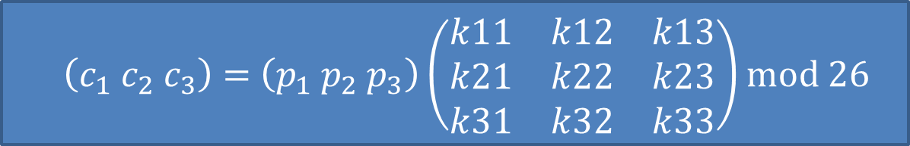
4) Hill Cipher
Hill cipher is based on linear algebra
Each letter is represented by numbers from 0 to 25 and calculations are done modulo 26.
Encryption and decryption can be given by the following formula:
Encryption:
Decryption:
C=PK mod 26
P=CK⁻¹ mod 26

Slide 70
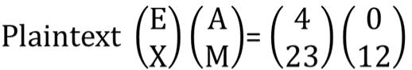
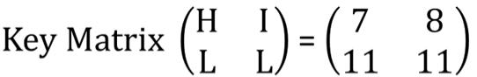
Hill Cipher Encryption
To encrypt a message using the Hill Cipher we must first turn our keyword and plaintext into a matrix (a 2 x 2 matrix or a 3 x 3 matrix, etc).
Example: Key = “HILL”, Plaintext = “EXAM”
a | b | c | d | e | f | g | h | i | j | k | l | m
0 | 1 | 2 | 3 | 4 | 5 | 6 | 7 | 8 | 9 | 10 | 11 | 12
n | o | p | q | r | s | t | u | v | w | x | y | z
13 | 14 | 15 | 16 | 17 | 18 | 19 | 20 | 21 | 22 | 23 | 24 | 25
Notes:
Exam

Slide 71
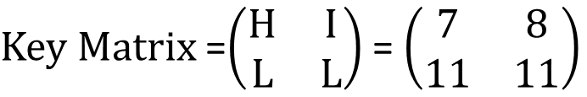
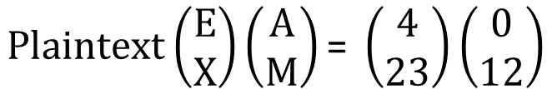
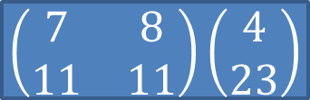
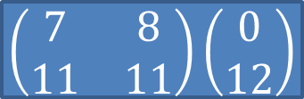
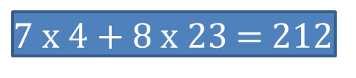
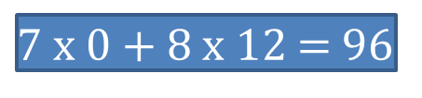
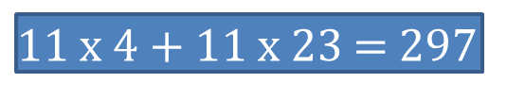
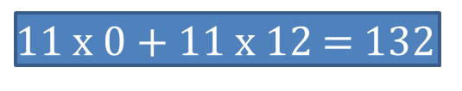
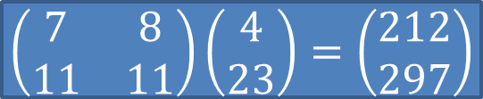
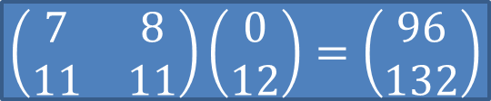

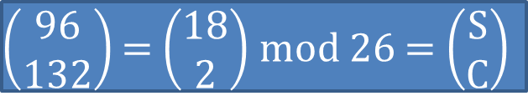
Hill Cipher Encryption (Cont…)
C=PK mod 26
Ciphertext = “ELSC”

Slide 72
Hill Cipher Decryption
Step:1 Find Inverse of key matrix
Step:2 Multiply the Multiplicative Inverse of the Determinant by the Adjoin Matrix
Step:3 Multiply inverse key matrix with ciphertext matrix to obtain plaintext matrix
P=CK⁻¹ mod 26

Slide 73
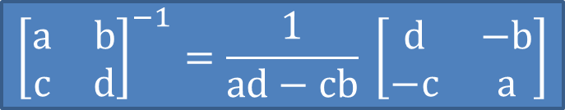
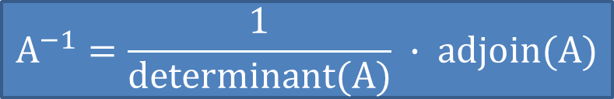
Step: 1 Inverse of key matrix
2 X 2 inverse of matrix
3 X 3 inverse of matrix

Slide 74
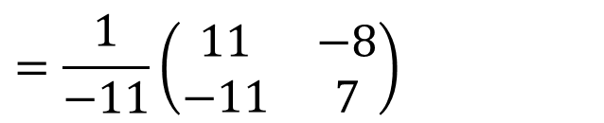
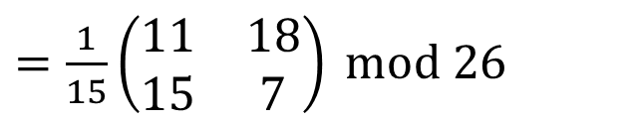
Step: 1 Inverse of key matrix
-11 mod 26 = 15
Because, modulo for negative number is = N- (B%N)
= 26 – (11%26)

Slide 75
Step: 2 Modular (Multiplicative) inverse
The inverse of a number A is 1/A since A * 1/A = 1
e.g. the inverse of 5 is 1/5
In modular arithmetic we do not have a division operation.
The modular inverse of A (mod C) is A⁻¹
(A * A⁻¹) ≡ 1 (mod C)
Example:
The modular inverse of A mod C is the A⁻¹ value that makes
A * A⁻¹ mod C = 1
A = 3, C = 11
Since (3*4) mod 11 = 1, 4 is modulo inverse of 3
A = 10, C = 17 , A⁻¹ = ?
12

Slide 76
Step 2: Modular (Multiplicative) inverse
Determinants’ multiplicative inverse Modulo 26
Determinant | 1 | 3 | 5 | 7 | 9 | 11 | 15 | 17 | 19 | 21 | 23 | 25
Inverse Modulo 26 | 1 | 9 | 21 | 15 | 3 | 19 | 7 | 23 | 11 | 5 | 17 | 25

Slide 77
Step 2: Multiply with adjoin of matrix

Slide 78
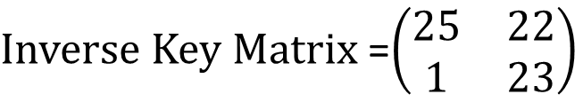
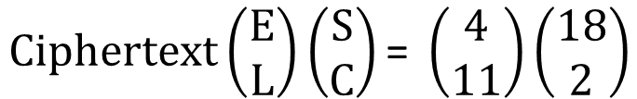
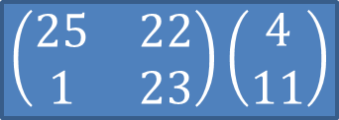
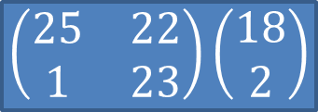
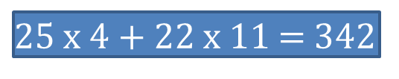
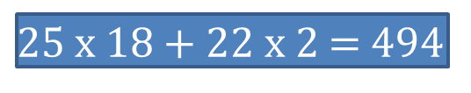
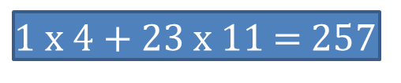
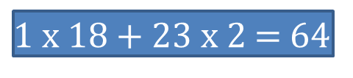
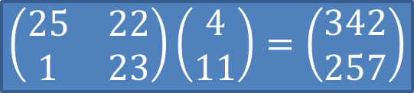
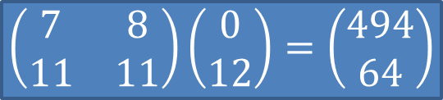
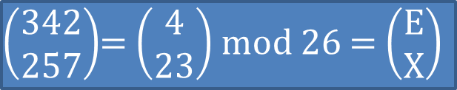

Hill Cipher Encryption (Cont…)
P=CK⁻¹ mod 26
Plaintext = “EXAM”

Slide 79
Polyalphabetic Ciphers
polyalphabetic substitution ciphers
improve security using multiple cipher alphabets
make cryptanalysis harder with more alphabets to guess and flatter frequency distribution
use a key to select which alphabet is used for each letter of the message
use each alphabet in turn
repeat from start after end of key is reached
Notes:
One approach to reducing the "spikyness" of natural language text is used the Playfair cipher which encrypts more than one letter at once. We now consider the other alternative, using multiple cipher alphabets in turn. This gives the attacker more work, since many alphabets need to be guessed and because the frequency distribution is more complex, since the same plaintext letter could be replaced by several ciphertext letters, depending on which alphabet is used. The general name for this approach is a polyalphabetic substitution cipher. All these techniques have the following features in common:
A set of related monoalphabetic substitution rules is used.
A key determines which particular rule is chosen for a given transformation.

Slide 80
Vigenère Cipher
simplest polyalphabetic substitution cipher
effectively multiple caesar ciphers
key is multiple letters long K = k₁ k₂ ... k_{d}
i^{th} letter specifies i^{th} alphabet to use
use each alphabet in turn
repeat from start after d letters in message
decryption simply works in reverse
Notes:
The best known, and one of the simplest, such algorithms is referred to as the Vigenère cipher, where the set of related monoalphabetic substitution rules consists of the 26 Caesar ciphers, with shifts of 0 through 25. Each cipher is denoted by a key letter, which is the ciphertext letter that substitutes for the plaintext letter ‘a’, and which are each used in turn, as shown next.

Slide 81
Example of Vigenère Cipher
write the plaintext out
write the keyword repeated above it
use each key letter as a caesar cipher key
encrypt the corresponding plaintext letter
eg using keyword deceptive
key: deceptivedeceptivedeceptive
plaintext: wearediscoveredsaveyourself
ciphertext:ZICVTWQNGRZGVTWAVZHCQYGLMGJ
Notes:
Discuss this simple example from text Stallings section 2.2.

Slide 82
Security of Vigenère Ciphers
have multiple ciphertext letters for each plaintext letter
hence letter frequencies are obscured
but not totally lost
start with letter frequencies
see if look monoalphabetic or not
if not, then need to determine number of alphabets, since then can attach each
Notes:
The Vigenère & related polyalphabetic ciphers still do not completely obscure the underlying language characteristics. The strength of this cipher is that there are multiple ciphertext letters for each plaintext letter, one for each unique letter of the keyword. Thus, the letter frequency information is obscured. However, not all knowledge of the plaintext structure is lost. The key to breaking them is to identify the number of translation alphabets, and then attack each separately. If a monoalphabetic substitution is used, then the statistical properties of the ciphertext should be the same as that of the language of the plaintext. If, on the other hand, a Vigenère cipher is suspected, then progress depends on determining the length of the keyword.

Slide 83
Autokey Cipher
ideally want a key as long as the message
Vigenère proposed the autokey cipher
with keyword is prefixed to message as key
knowing keyword can recover the first few letters
use these in turn on the rest of the message
but still have frequency characteristics to attack
eg. given key deceptive
key: deceptivewearediscoveredsav
plaintext: wearediscoveredsaveyourself
ciphertext:ZICVTWQNGKZEIIGASXSTSLVVWLA
Notes:
Taking the polyalphabetic idea to the extreme, want as many different translation alphabets as letters in the message being sent. One way of doing this with a smallish key, is to use the Autokey cipher.
The example uses the keyword "DECEPTIVE" prefixed to as much of the message "WEAREDISCOVEREDSAV" as is needed. When deciphering, recover the first 9 letters using the keyword "DECEPTIVE". Then instead of repeating the keyword, start using the recovered letters from the message "WEAREDISC". As recover more letters, have more of key to recover later letters.
Problem is that the same language characteristics are used by the key as the message. ie. a key of 'E' will be used more often than a 'T' etc hence an 'E' encrypted with a key of 'E' occurs with probability (0.1275)2 = 0.01663, about twice as often as a 'T' encrypted with a key of 'T' have to use a larger frequency table, but it exists given sufficient ciphertext this can be broken.

Slide 84
Vernam Cipher
ultimate defense is to use a key as long as the plaintext
with no statistical relationship to it
invented by AT&T engineer Gilbert Vernam in 1918
originally proposed using a very long but eventually repeating key
Notes:
The ultimate defense against such a cryptanalysis is to choose a keyword that is as long as the plaintext and has no statistical relationship to it. Such a system was introduced by an AT&T engineer named Gilbert Vernam in 1918. His system works on binary data (bits0 rather than letters. The system can be expressed succinctly as follows: c_{i} = p_{i} XOR k_{i}
The essence of this technique is the means of construction of the key. Vernam proposed the use of a running loop of tape that eventually repeated the key, so that in fact the system worked with a very long but repeating keyword. Although such a scheme, with a long key, presents formidable cryptanalytic difficulties, it can be broken with sufficient ciphertext, the use of known or probable plaintext sequences, or both.

Slide 85
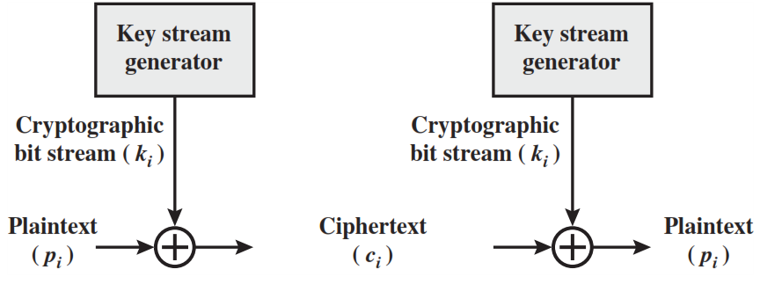
Vernam Cipher
The ciphertext is generated by applying the logical XOR operation to the individual bits of plaintext and the key stream.

Slide 86
One-Time Pad
if a truly random key as long as the message is used, the cipher will be secure
called a One-Time pad
is unbreakable since ciphertext bears no statistical relationship to the plaintext
since for any plaintext & any ciphertext there exists a key mapping one to other
can only use the key once though
problems in generation & safe distribution of key
Notes:
The One-Time Pad is an evolution of the Vernham cipher. An Army Signal Corp officer, Joseph Mauborgne, proposed an improvement using a random key that was truly as long as the message, with no repetitions, which thus totally obscures the original message. It produces random output that bears no statistical relationship to the plaintext. Because the ciphertext contains no information whatsoever about the plaintext, there is simply no way to break the code, since any plaintext can be mapped to any ciphertext given some key.
The one-time pad offers complete security but, in practice, has two fundamental difficulties:
There is the practical problem of making large quantities of random keys.
And the problem of key distribution and protection, where for every message to be sent, a key of equal length is needed by both sender and receiver.
Because of these difficulties, the one-time pad is of limited utility, and is useful primarily for low-bandwidth channels requiring very high security. The one-time pad is the only cryptosystem that exhibits what is referred to as perfect secrecy.

Slide 87
Transposition Ciphers
now consider classical transposition or permutation ciphers
these hide the message by rearranging the letter order
without altering the actual letters used
can recognise these since have the same frequency distribution as the original text
Notes:
All the techniques examined so far involve the substitution of a ciphertext symbol for a plaintext symbol. A very different kind of mapping is achieved by performing some sort of permutation on the plaintext letters. This technique is referred to as a transposition cipher, and form the second basic building block of ciphers. The core idea is to rearrange the order of basic units (letters/bytes/bits) without altering their actual values.

Slide 88
Rail Fence cipher
write message letters out diagonally over a number of rows
then read off cipher row by row
eg. write message out as:
m e m a t r h t g p r y
e t e f e t e o a a t
giving ciphertext
MEMATRHTGPRYETEFETEOAAT
Notes:
The simplest such cipher is the rail fence technique, in which the plaintext is written down as a sequence of diagonals and then read off as a sequence of rows.
The example message is: "meet me after the toga party" with a rail fence of depth 2.
This sort of thing would be trivial to cryptanalyze.

Slide 89
Row Transposition Ciphers
is a more complex transposition
write letters of message out in rows over a specified number of columns
then reorder the columns according to some key before reading off the rows
Key: 4312567
Column Out 4 3 1 2 5 6 7
Plaintext: a t t a c k p
o s t p o n e
d u n t i l t
w o a m x y z
Ciphertext: TTNAAPTMTSUOAODWCOIXKNLYPETZ
Notes:
A more complex transposition cipher is to write the message in a rectangle, row by row, and read the message off shuffling the order of the columns in each row. The order of the columns then becomes the key to the algorithm. In the example shown, the key is 4312567, that is use column 4 first, then column3, then 1 etc (as shown in the Column Out row).
A pure transposition cipher is easily recognized because it has the same letter frequencies as the original plaintext. For the type of columnar transposition just shown, cryptanalysis is fairly straightforward and involves laying out the ciphertext in a matrix and playing around with column positions. Digram and trigram frequency tables can be useful.

Slide 90
Product Ciphers
ciphers using substitutions or transpositions are not secure because of language characteristics
hence consider using several ciphers in succession to make harder, but:
two substitutions make a more complex substitution
two transpositions make more complex transposition
but a substitution followed by a transposition makes a new much harder cipher
this is bridge from classical to modern ciphers
Notes:
Have seen that ciphers based on just substitutions or transpositions are not secure, and can be attacked because they do not sufficient obscure the underlying language structure
So consider using several ciphers in succession to make harder.
A substitution followed by a transposition is known as a Product Cipher, and makes a new much more secure cipher, and forms the bridge to modern ciphers.

Slide 91
Rotor Machines
before modern ciphers, rotor machines were most common complex ciphers in use
widely used in WW2
German Enigma, Allied Hagelin, Japanese Purple
implemented a very complex, varying substitution cipher
used a series of cylinders, each giving one substitution, which rotated and changed after each letter was encrypted
with 3 cylinders have 26³=17576 alphabets
Notes:
The next major advance in ciphers required use of mechanical cipher machines which enabled to use of complex varying substitutions.
A rotor machine consists of a set of independently rotating cylinders through which electrical pulses can flow. Each cylinder has 26 input pins and 26 output pins, with internal wiring that connects each input pin to a unique output pin. If we associate each input and output pin with a letter of the alphabet, then a single cylinder defines a monoalphabetic substitution. After each input key is depressed, the cylinder rotates one position, so that the internal connections are shifted accordingly. The power of the rotor machine is in the use of multiple cylinders, in which the output pins of one cylinder are connected to the input pins of the next, and with the cylinders rotating like an “odometer”, leading to a very large number of substitution alphabets being used, eg with 3 cylinders have 26³=17576 alphabets used.
They were extensively used in world war 2, and the history of their use and analysis is one of the great stories from WW2.

Slide 92
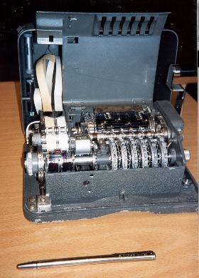
Hagelin Rotor Machine
Notes:
This photo of an Allied Hagelin machine was taken by Lawrie Brown at Eurocrypt'93 in Norway. Note pen for scale, and the rotating cipher wheels near the front.

Slide 93
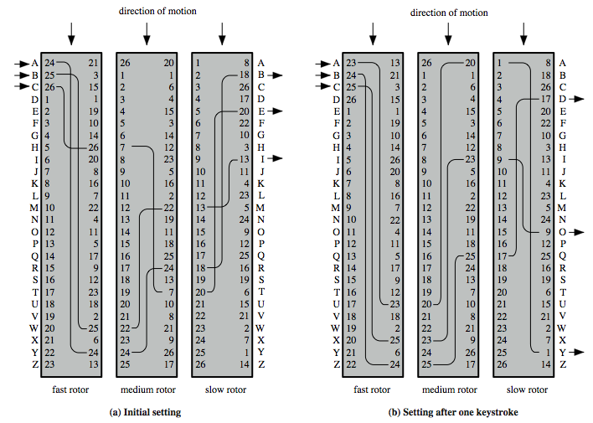
Rotor Machine Principles
Notes:
The basic principle of the rotor machine is illustrated in Figure 2.8. The machine consists of a set of independently rotating cylinders through which electrical pulses can flow. Each cylinder has 26 input pins and 26 output pins, with internal wiring that connects each input pin to a unique output pin. If we associate each input and output pin with a letter of the alphabet, then a single cylinder defines a monoalphabetic substitution. If an operator depresses the key for the letter A, an electric signal is applied to the first pin of the first cylinder and flows through the internal connection to the twenty-fifth output pin. Consider a machine with a single cylinder. After each input key is depressed, the cylinder rotates one position, so that the internal connections are shifted accordingly. Thus, a different monoalphabetic substitution cipher is defined. After 26 letters of plaintext, the cylinder would be back to the initial position. Thus, we have a polyalphabetic substitution algorithm with a period of 26.
A single-cylinder system is trivial and does not present a formidable cryptanalytic task. The power of the rotor machine is in the use of multiple cylinders, in which the output pins of one cylinder are connected to the input pins of the next. Figure 2.8 shows a three-cylinder system. With multiple cylinders, the one closest to the operator input rotates one pin position with each keystroke. The right half of Figure 2.8 shows the system's configuration after a single keystroke. For every complete rotation of the inner cylinder, the middle cylinder rotates one pin position. Finally, for every complete rotation of the middle cylinder, the outer cylinder rotates one pin position. The result is that there are 26 " 26 " 26 = 17,576 different substitution alphabets used before the system repeats.

Slide 94
Steganography
an alternative to encryption
hides existence of message
using only a subset of letters/words in a longer message marked in some way
using invisible ink
hiding in LSB in graphic image or sound file
has drawbacks
high overhead to hide relatively few info bits
advantage is can obscure encryption use
Notes:
Steganography is an alternative to encryption which hides the very existence of a message by some means. There are a large range of techniques for doing this.
Steganography has a number of drawbacks when compared to encryption. It requires a lot of overhead to hide a relatively few bits of information.
Also, once the system is discovered, it becomes virtually worthless, although a message can be first encrypted and then hidden using steganography. The advantage of steganography is that it can be employed by parties who have something to lose should the fact of their secret communication (not necessarily the content) be discovered.

Slide 95
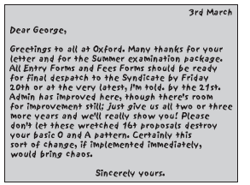

Slide 96
Demo
https://stylesuxx.github.io/steganography/

Slide 97
Chapter 4 – Basic Concepts in Number Theory and Finite Fields
The next morning at daybreak, Star flew indoors, seemingly keen for a lesson. I said, "Tap eight." She did a brilliant exhibition, first tapping it in 4, 4, then giving me a hasty glance and doing it in 2, 2, 2, 2, before coming for her nut. It is astonishing that Star learned to count up to 8 with no difficulty, and of her own accord discovered that each number could be given with various different divisions, this leaving no doubt that she was consciously thinking each number. In fact, she did mental arithmetic, although unable, like humans, to name the numbers. But she learned to recognize their spoken names almost immediately and was able to remember the sounds of the names. Star is unique as a wild bird, who of her own free will pursued the science of numbers with keen interest and astonishing intelligence.
— Living with Birds, Len Howard
Notes:
Intro quote.

Slide 98
Introduction
will now introduce finite fields
of increasing importance in cryptography
AES, Elliptic Curve, IDEA, Public Key
concern operations on “numbers”
where what constitutes a “number” and the type of operations varies considerably
start with basic number theory concepts
Notes:
Finite fields have become increasingly important in cryptography. A number of cryptographic algorithms rely heavily on properties of finite fields, notably the Advanced Encryption Standard (AES) and elliptic curve cryptography. The main purpose of this chapter is to provide the reader with sufficient background on the concepts of finite fields to be able to understand the design of AES and other cryptographic algorithms that use finite fields. We begin, in the first three sections, with some basic concepts from number theory that are needed in the remainder of the chapter; these include divisibility, the Euclidian algorithm, and modular arithmetic.

Slide 99
Divisors
say a non-zero number b divides a if for some m have a=mb (a,b,m all integers)
that is b divides into a with no remainder
denote this b|a
and say that b is a divisor of a
eg. all of 1,2,3,4,6,8,12,24 divide 24
eg. 13 | 182; –5 | 30; 17 | 289; –3 | 33; 17 | 0
Notes:
Define concept of “divisors”. We say that a nonzero b divides a if a=m.b for some m, where a, b, and m are integers. That is, b divides a if there is no remainder on division. Can denote this as b|a, and say that b is a divisor of a. For example, the positive divisors of 24 are 1,2,3,4,6,8,12, and 24. And have 13 | 182; –5 | 30; 17 | 289; –3 | 33; 17 | 0.

Slide 100
Properties of Divisibility
If a|1, then a = ±1.
If a|b and b|a, then a = ±b.
Any b /= 0 divides 0.
If a | b and b | c, then a | c
e.g. 11 | 66 and 66 | 198 x 11 | 198
If b|g and b|h, then b|(mg + nh)
for arbitrary integers m and n
e.g. b = 7; g = 14; h = 63; m = 3; n = 2
hence 7|14 and 7|63
Notes:
Subsequently, we will need some simple properties of divisibility for integers, which are as follows:
• If a|1, then a = ±1.
• If a|b and b|a, then a = ±b.
• Any b ! 0 divides 0.
• If a | b and b | c, then a | c
• If b|g and b|h, then b|(mg + nh) for arbitrary integers m and n. e.g. b = 7; g = 14; h = 63; m = 3; n = 2. 7|14 and 7|63. To show: 7|(3 x 14 + 2 x 63) We have (3 x 14 + 2 x 63) = 7(3 x 2 + 2 x 9) And it is obvious that 7|(7(3 x 2 + 2 x 9))

Slide 101
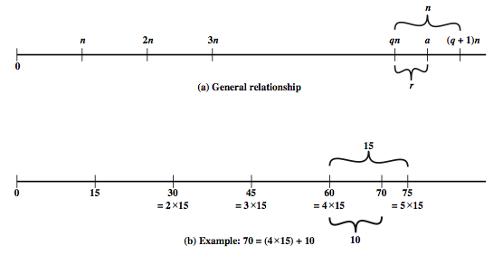
Division Algorithm
if divide a by n get integer quotient q and integer remainder r such that:
a = qn + r where 0 <= r < n; q = floor(a/n)
remainder r often referred to as a residue
Notes:
Given any positive integer n and any nonnegative integer a, if we divide a by n, we get an integer quotient q and an integer remainder r that obey the following relationship: a = qn + r, where 0 <= r < n; q = floor(a/n) which is referred to as the division algorithm. The remainder r is often referred to as a residue.
Figure 4.1a demonstrates that, given a and positive n, it is always possible to find q and r that satisfy the preceding relationship. Represent the integers on the number line; a will fall somewhere on that line (positive a is shown, a similar demonstration can be made for negative a). Starting at 0, proceed to n, 2n, up to qn such that qn <= a and (q + 1)n > a. The distance from qn to a is r, and we have found the unique values of q and r.
For example:
a = 11; n = 7; 11 = 1 x 7 + 4; r = 4 q = 1
a = –11; n = 7; –11 = (–2) x 7 + 3; r = 3 q = –2
Figure 4.1b provides another example.

Slide 102
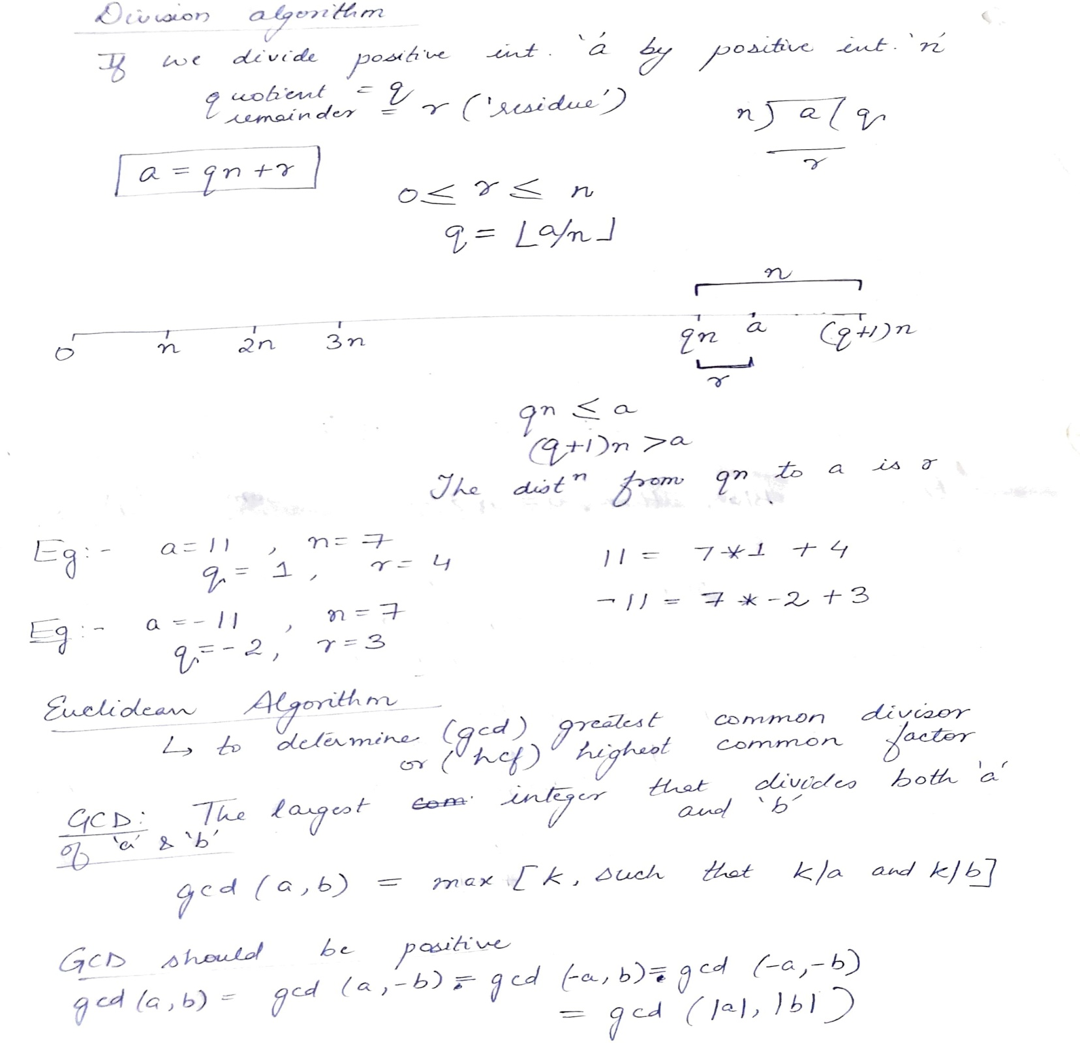

Slide 103


Slide 104
Greatest Common Divisor (GCD)
a common problem in number theory
GCD (a,b) of a and b is the largest integer that divides evenly into both a and b
eg GCD(60,24) = 12
define gcd(0, 0) = 0
often want no common factors (except 1) define such numbers as relatively prime
eg GCD(8,15) = 1
hence 8 & 15 are relatively prime
Notes:
One of the basic techniques of number theory is the Euclidean algorithm, which is a simple procedure for determining the greatest common divisor of two positive integers. Use the notation gcd(a,b) to mean the greatest common divisor of a and b. The positive integer c is said to be the greatest common divisor of a and b if c is a divisor of a and of b; and any divisor of a and b is a divisor of c. We also define gcd(0, 0) = 0.
State that two integers a and b are relatively prime if their only common positive integer factor is 1, ie GCD(a,b)=1.

Slide 105
Euclidean Algorithm
an efficient way to find the GCD(a,b)
uses theorem that:
GCD(a,b) = GCD(b, a mod b)
Euclidean Algorithm to compute GCD(a,b) is:
Euclid(a,b)
if (b=0) then return a;
else return Euclid(b, a mod b);
Notes:
We now describe an algorithm credited to Euclid for easily finding the greatest common divisor of two integers. This algorithm has significance subsequently in this chapter. The Euclidean algorithm is an efficient way to find the GCD(a,b), and is derived from the observation that if a & b have a common factor d (ie. a=m.d & b=n.d) then d is also a factor in any difference between them, vis: a-p.b = (m.d)-p.(n.d) = d.(m-p.n). See text for more detailed proof. Euclid's Algorithm keeps computing successive differences until it vanishes, at which point the greatest common divisor has been reached. Some pseudo-code from the text for this algorithm is shown.

Slide 106
Example GCD(1970,1066)
1970 = 1 x 1066 + 904 gcd(1066, 904)
1066 = 1 x 904 + 162 gcd(904, 162)
904 = 5 x 162 + 94 gcd(162, 94)
162 = 1 x 94 + 68 gcd(94, 68)
94 = 1 x 68 + 26 gcd(68, 26)
68 = 2 x 26 + 16 gcd(26, 16)
26 = 1 x 16 + 10 gcd(16, 10)
16 = 1 x 10 + 6 gcd(10, 6)
10 = 1 x 6 + 4 gcd(6, 4)
6 = 1 x 4 + 2 gcd(4, 2)
4 = 2 x 2 + 0 gcd(2, 0)
Notes:
Illustrate how we can compute successive instances of GCD(a,b) = GCD(b,a mod b).
Note this MUST always terminate since will eventually get a mod b = 0 (ie no remainder left).
Answer is then the last non-zero value. In this case GCD(1970,1066)=2.

Slide 107
GCD(1160718174, 316258250)
Dividend Divisor Quotient Remainder
a = 1160718174 b = 316258250 q1 = 3 r1 = 211943424
b = 316258250 r1 = 211943424 q2 = 1 r2 = 104314826
r1 = 211943424 r2 = 104314826 q3 = 2 r3 = 3313772
r2 = 104314826 r3 = 3313772 q4 = 31 r4 = 1587894
r3 = 3313772 r4 = 1587894 q5 = 2 r5 = 137984
r4 = 1587894 r5 = 137984 q6 = 11 r6 = 70070
r5 = 137984 r6 = 70070 q7 = 1 r7 = 67914
r6 = 70070 r7 = 67914 q8 = 1 r8 = 2516
r7 = 67914 r8 = 2516 q9 = 31 r9 = 1078
r8 = 2516 r9 = 1078 q10 = 2 r10 = 0
Notes:
This example shows hpw to find d = gcd(a, b) = gcd(1160718174, 316258250), shown in tabular form. In this example, we begin by dividing 1160718174 by 316258250, which gives 3 with a remainder of 211943424. Next we take 316258250 and divide it by 211943424. The process continues until we get a remainder of 0, yielding a result of 1078

Slide 108
Modular Arithmetic
define modulo operator “a mod n” to be remainder when a is divided by n
where integer n is called the modulus
b is called a residue of a mod n
since with integers can always write: a = qn + b
usually chose smallest positive remainder as residue
ie. 0 <= b <= n-1
process is known as modulo reduction
eg. -12 mod 7 = -5 mod 7 = 2 mod 7 = 9 mod 7
a & b are congruent if: a mod n = b mod n
when divided by n, a & b have same remainder
eg. 100 = 34 mod 11
Notes:
Given any positive integer n and any nonnegative integer a, if we divide a by n, we get an integer quotient q and an integer remainder r. In modular arithmetic we are only interested in the remainder (or residue) after division by some modulus, and results with the same remainder are regarded as equivalent. Two integers a and b are said to be congruent modulo n, if (a mod n) =(b mod n).

Slide 109
Modular Arithmetic Operations
can perform arithmetic with residues
uses a finite number of values, and loops back from either end
Z_{n} = {0, 1, . . . , (n – 1)}
modular arithmetic is when do addition & multiplication and modulo reduce answer
can do reduction at any point, ie
a+b mod n = [a mod n + b mod n] mod n
Notes:
Note that the (mod n) operator maps all integers into the set of integers {0, 1, . . . (n – 1)}, denoted Z_{n}. This is referred to as the set of residues, or residue classes (mod n). We can perform arithmetic operations within the confines of this set, and this technique is known as modular arithmetic. Finding the smallest nonnegative integer to which k is congruent modulo n is called reducing k modulo n. Then note some important properties of modular arithmetic which mean you can modulo reduce at any point and obtain an equivalent answer.

Slide 110
Modular Arithmetic Operations
[(a mod n) + (b mod n)] mod n = (a + b) mod n
[(a mod n) – (b mod n)] mod n = (a – b) mod n
[(a mod n) x (b mod n)] mod n = (a x b) mod n
e.g.
[(11 mod 8) + (15 mod 8)] mod 8 = 10 mod 8 = 2 (11 + 15) mod 8 = 26 mod 8 = 2
[(11 mod 8) – (15 mod 8)] mod 8 = –4 mod 8 = 4 (11 – 15) mod 8 = –4 mod 8 = 4
[(11 mod 8) x (15 mod 8)] mod 8 = 21 mod 8 = 5 (11 x 15) mod 8 = 165 mod 8 = 5
Notes:
Modular arithmetic exhibits the properties shown, see text for details & proofs.
Here are examples of the three properties:
Given 11 mod 8 = 3; 15 mod 8 = 7
[(11 mod 8) + (15 mod 8)] mod 8 = 10 mod 8 = 2 (11 + 15) mod 8 = 26 mod 8 = 2
[(11 mod 8) – (15 mod 8)] mod 8 = –4 mod 8 = 4 (11 – 15) mod 8 = –4 mod 8 = 4
[(11 mod 8) x (15 mod 8)] mod 8 = 21 mod 8 = 5 (11 x 15) mod 8 = 165 mod 8 = 5

Slide 111
Modulo 8 Addition Example
+ | 0 | 1 | 2 | 3 | 4 | 5 | 6 | 7
0 | 0 | 1 | 2 | 3 | 4 | 5 | 6 | 7
1 | 1 | 2 | 3 | 4 | 5 | 6 | 7 | 0
2 | 2 | 3 | 4 | 5 | 6 | 7 | 0 | 1
3 | 3 | 4 | 5 | 6 | 7 | 0 | 1 | 2
4 | 4 | 5 | 6 | 7 | 0 | 1 | 2 | 3
5 | 5 | 6 | 7 | 0 | 1 | 2 | 3 | 4
6 | 6 | 7 | 0 | 1 | 2 | 3 | 4 | 5
7 | 7 | 0 | 1 | 2 | 3 | 4 | 5 | 6
Notes:
Example showing addition in GF(8), from Stallings Table 4.2a. Table 4.2 provides an illustration of modular addition and multiplication modulo 8. Looking at addition, the results are straightforward and there is a regular pattern to the matrix. Both matrices are symmetric about the main diagonal, in conformance to the commutative property of addition and multiplication. As in ordinary addition, there is an additive inverse, or negative, to each integer in modular arithmetic. In this case, the negative of an integer x is the integer y such that (x + y) mod 8 = 0. To find the additive inverse of an integer in the left-hand column, scan across the corresponding row of the matrix to find the value 0; the integer at the top of that column is the additive inverse; thus (2 + 6) mod 8 = 0.

Slide 112
Modulo 8 Multiplication
+ | 0 | 1 | 2 | 3 | 4 | 5 | 6 | 7
0 | 0 | 0 | 0 | 0 | 0 | 0 | 0 | 0
1 | 0 | 1 | 2 | 3 | 4 | 5 | 6 | 7
2 | 0 | 2 | 4 | 6 | 0 | 2 | 4 | 6
3 | 0 | 3 | 6 | 1 | 4 | 7 | 2 | 5
4 | 0 | 4 | 0 | 4 | 0 | 4 | 0 | 4
5 | 0 | 5 | 2 | 7 | 4 | 1 | 6 | 3
6 | 0 | 6 | 4 | 2 | 0 | 6 | 4 | 2
7 | 0 | 7 | 6 | 5 | 4 | 3 | 2 | 1
Notes:
Continuing the example showing multiplication in GF(8), from Stallings Table 4.2b. Both matrices are symmetric about the main diagonal, in conformance to the commutative property of addition and multiplication. Similarly, the entries in the multiplication table are straightforward. In ordinary arithmetic, there is a multiplicative inverse, or reciprocal, to each integer. In modular arithmetic mod 8, the multiplicative inverse of x is the integer y such that (x x y) mod 8 = 1 mod 8. Now, to find the multiplicative inverse of an integer from the multiplication table, scan across the matrix in the row for that integer to find the value 1; the integer at the top of that column is the multiplicative inverse; thus (3 x 3) mod 8 = 1. Note that not all integers mod 8 have a multiplicative inverse; more about that later.

Slide 113

Modular Arithmetic Properties
Notes:
If we perform modular arithmetic within Z_{n}, the properties shown in Table 4.3 hold for integers in Z_{n} We show in the next section that this implies that Z_{n} is a commutative ring with a multiplicative identity element. Note that unlike ordinary arithmetic, the following statement is true only with the attached condition:
if (a x b) = (a x c) (mod n) then b = c (mod n) if a is relatively prime to n
In general, an integer has a multiplicative inverse in Z_{n} if that integer is relatively prime to n. Table 4.2 cin the text shows that the integers 1, 3, 5, and 7 have a multiplicative inverse in Z 8, but 2, 4, and 6 do not.

Slide 114


Slide 115


Slide 116


Slide 117


Slide 118


Slide 119


Slide 122


Slide 123


Slide 126


Slide 128


Slide 129


Slide 130


Slide 131


Slide 132


Slide 133
Group
a set of elements or “numbers”
may be finite or infinite
with some operation whose result is also in the set (closure)
obeys:
associative law: (a.b).c = a.(b.c)
has identity e: e.a = a.e = a
has inverses a⁻¹: a.a⁻¹ = e
if commutative a.b = b.a
then forms an abelian group
Notes:
Groups, rings, and fields are the fundamental elements of a branch of mathematics known as abstract algebra, or modern algebra. In abstract algebra, we are concerned with sets on whose elements we can operate algebraically; that is, we can combine two elements of the set, perhaps in several ways, to obtain a third element of the set. These operations are subject to specific rules, which define the nature of the set. By convention, the notation for the two principal classes of operations on set elements is usually the same as the notation for addition and multiplication on ordinary numbers. However, it is important to note that, in abstract algebra, we are not limited to ordinary arithmetical operations.
A group G, sometimes denoted by {G, • }, is a set of elements with a binary operation, denoted by •, that associates to each ordered pair (a, b) of elements in G an element (a • b) in G, such that the following axioms are obeyed: Closure, Associative, Identity element, Inverse element.
Note - we have used . as operator: could be addition +, multiplication x or any other mathematical operator. A group can have a finite (fixed) number of elements, or it may be infinite. Note that integers (+ve, -ve and 0) using addition form an infinite abelian group. So do real numbers using multiplication.

Slide 134
Cyclic Group
define exponentiation as repeated application of operator
example: a³ = a.a.a
and let identity be: e=a⁰
a group is cyclic if every element is a power of some fixed element
ie b = a^{k} for some a and every b in group
a is said to be a generator of the group
Notes:
Define exponentiation in a group as the repeated use of the group operator. Note that we are most familiar with it being applied to multiplication, but it is more general than that.
If the repeated use of the operator on some value a in the group results in every possible value being created, then the group is said to be cyclic, and a is a generator of (or generates) the group G.

Slide 135
Ring
a set of “numbers”
with two operations (addition and multiplication) which form:
an abelian group with addition operation
and multiplication:
has closure
is associative
distributive over addition: a(b+c) = ab + ac
if multiplication operation is commutative, it forms a commutative ring
if multiplication operation has an identity and no zero divisors, it forms an integral domain
Notes:
Next describe a ring. In essence, a ring is a set in which we can do addition, subtraction [a – b = a + (–b)], and multiplication without leaving the set, and which obeys the associative and distributive laws. We denote a Ring as {R,+,.}
With respect to addition and multiplication, the set of all n-square matrices over the real numbers form a ring. The set of integers with addition & multiplication form an integral domain.

Slide 136
Field
a set of numbers
with two operations which form:
abelian group for addition
abelian group for multiplication (ignoring 0)
ring
have hierarchy with more axioms/laws
group -> ring -> field
Notes:
Lastly define a field. In essence, a field is a set in which we can do addition, subtraction, multiplication, and division without leaving the set. Division is defined with the following rule: a/b = a (b^{–1}). We denote a Field as {F,+,.}
Examples of fields are: rational numbers, real numbers, complex numbers. Note that integers are NOT a field since there are no multiplicative inverses (except for 1).

Slide 137

Group, Ring, Field
Notes:
These are terms we use for different sorts of "number systems", ones obeying different sets of laws. From group to ring to field we get more and more laws being obeyed, as shown here in Stallings Figure 4.2.
As a memory aid, can use the acronym for groups: CAIN (Closure Associative Identity iNverse) & ABEL. Mostly we need to compute with Rings, if not Fields. When we do arithmetic modulo a prime, we have a field.

Slide 138
Finite (Galois) Fields
finite fields play a key role in cryptography
can show number of elements in a finite field must be a power of a prime p^{n}
known as Galois fields
denoted GF(p^{n})
in particular often use the fields:
GF(p)
GF(2^{n})
Notes:
Infinite fields are not of particular interest in the context of cryptography. However, finite fields play a crucial role in many cryptographic algorithms. It can be shown that the order of a finite field (number of elements in the field) must be a positive power of a prime, & these are known as Galois fields, in honor of the mathematician who first studied finite fields, & are denoted GF(p^n). We are most interested in the cases where either n=1 - GF(p), or p=2 - GF(2^n).

Slide 139
Galois Fields GF(p)
GF(p) is the set of integers {0,1, … , p-1} with arithmetic operations modulo prime p
these form a finite field
since have multiplicative inverses
find inverse with Extended Euclidean algorithm
hence arithmetic is “well-behaved” and can do addition, subtraction, multiplication, and division without leaving the field GF(p)
Notes:
Start by considering GF(p) over the set of integers {0…p-1} with addition & multiplication modulo p. This forms a “well-behaved” finite field. Can find an inverse using the Extended Euclidean algorithm.

Slide 140
GF(7) Multiplication Example
× | 0 | 1 | 2 | 3 | 4 | 5 | 6
0 | 0 | 0 | 0 | 0 | 0 | 0 | 0
1 | 0 | 1 | 2 | 3 | 4 | 5 | 6
2 | 0 | 2 | 4 | 6 | 1 | 3 | 5
3 | 0 | 3 | 6 | 2 | 5 | 1 | 4
4 | 0 | 4 | 1 | 5 | 2 | 6 | 3
5 | 0 | 5 | 3 | 1 | 6 | 4 | 2
6 | 0 | 6 | 5 | 4 | 3 | 2 | 1
Notes:
Table 4.5 shows arithmetic operations in GF(7). This is a field of order 7 using modular arithmetic modulo 7. As can be seen, it satisfies all of the properties required of a field (Figure 4.2). Compare this table with Table 4.2. In the latter case, we see that using modular arithmetic modulo 8, is not a field.

Slide 141
Polynomial Arithmetic
can compute using polynomials
f(x) = a_{n}x^{n} + a_{n-1}x^{n-1} + … + a₁x + a₀ = ∑ a_{i}x^{i}
nb. not interested in any specific value of x
which is known as the indeterminate
several alternatives available
ordinary polynomial arithmetic
poly arithmetic with coords mod p
poly arithmetic with coords mod p and polynomials mod m(x)
Notes:
Next introduce the interesting subject of polynomial arithmetic, using polynomials in a single variable x, with several variants as listed above.
Note we are usually not interested in evaluating a polynomial for any particular value of x, which is thus referred to as the indeterminate.

Slide 142
Ordinary Polynomial Arithmetic
add or subtract corresponding coefficients
multiply all terms by each other
eg
let f(x) = x³ + x² + 2 and g(x) = x² – x + 1
f(x) + g(x) = x³ + 2x² – x + 3
f(x) – g(x) = x³ + x + 1
f(x) x g(x) = x⁵ + 3x² – 2x + 2
Notes:
Polynomial arithmetic includes the operations of addition, subtraction, and multiplication, defined in the usual way, ie add or subtract corresponding coefficients, or multiply all terms by each other. The examples are from the text.

Slide 143
Polynomial Arithmetic with Modulo Coefficients
when computing value of each coefficient do calculation modulo some value
forms a polynomial ring
could be modulo any prime
but we are most interested in mod 2
ie all coefficients are 0 or 1
eg. let f(x) = x³ + x² and g(x) = x² + x + 1
f(x) + g(x) = x³ + x + 1
f(x) x g(x) = x⁵ + x²
Notes:
Consider variant where now when computing value of each coefficient do the calculation modulo some value, usually a prime. If the coefficients are computed in a field (eg GF(p)), then division on the polynomials is possible, and we have a polynomial ring. Are most interested in using GF(2) - ie all coefficients are 0 or 1, and any addition/subtraction of coefficients is done mod 2 (ie 2x is the same as 0x!), which is just the common XOR function.

Slide 144
Using a Generator
equivalent definition of a finite field
a generator g is an element whose powers generate all non-zero elements
in F have 0, g⁰, g¹, …, g^{q-2}
can create generator from root of the irreducible polynomial
then implement multiplication by adding exponents of generator
Notes:
There is an equivalent technique for defining a finite field of the form GF(2^{n}) using the same irreducible polynomial, based on powers of a generator of the group, which gives a nice implementation of multiplication. The generator can be found from the root of the irreducible polynomial, as discussed in the text.

Slide 145


